Slide 1
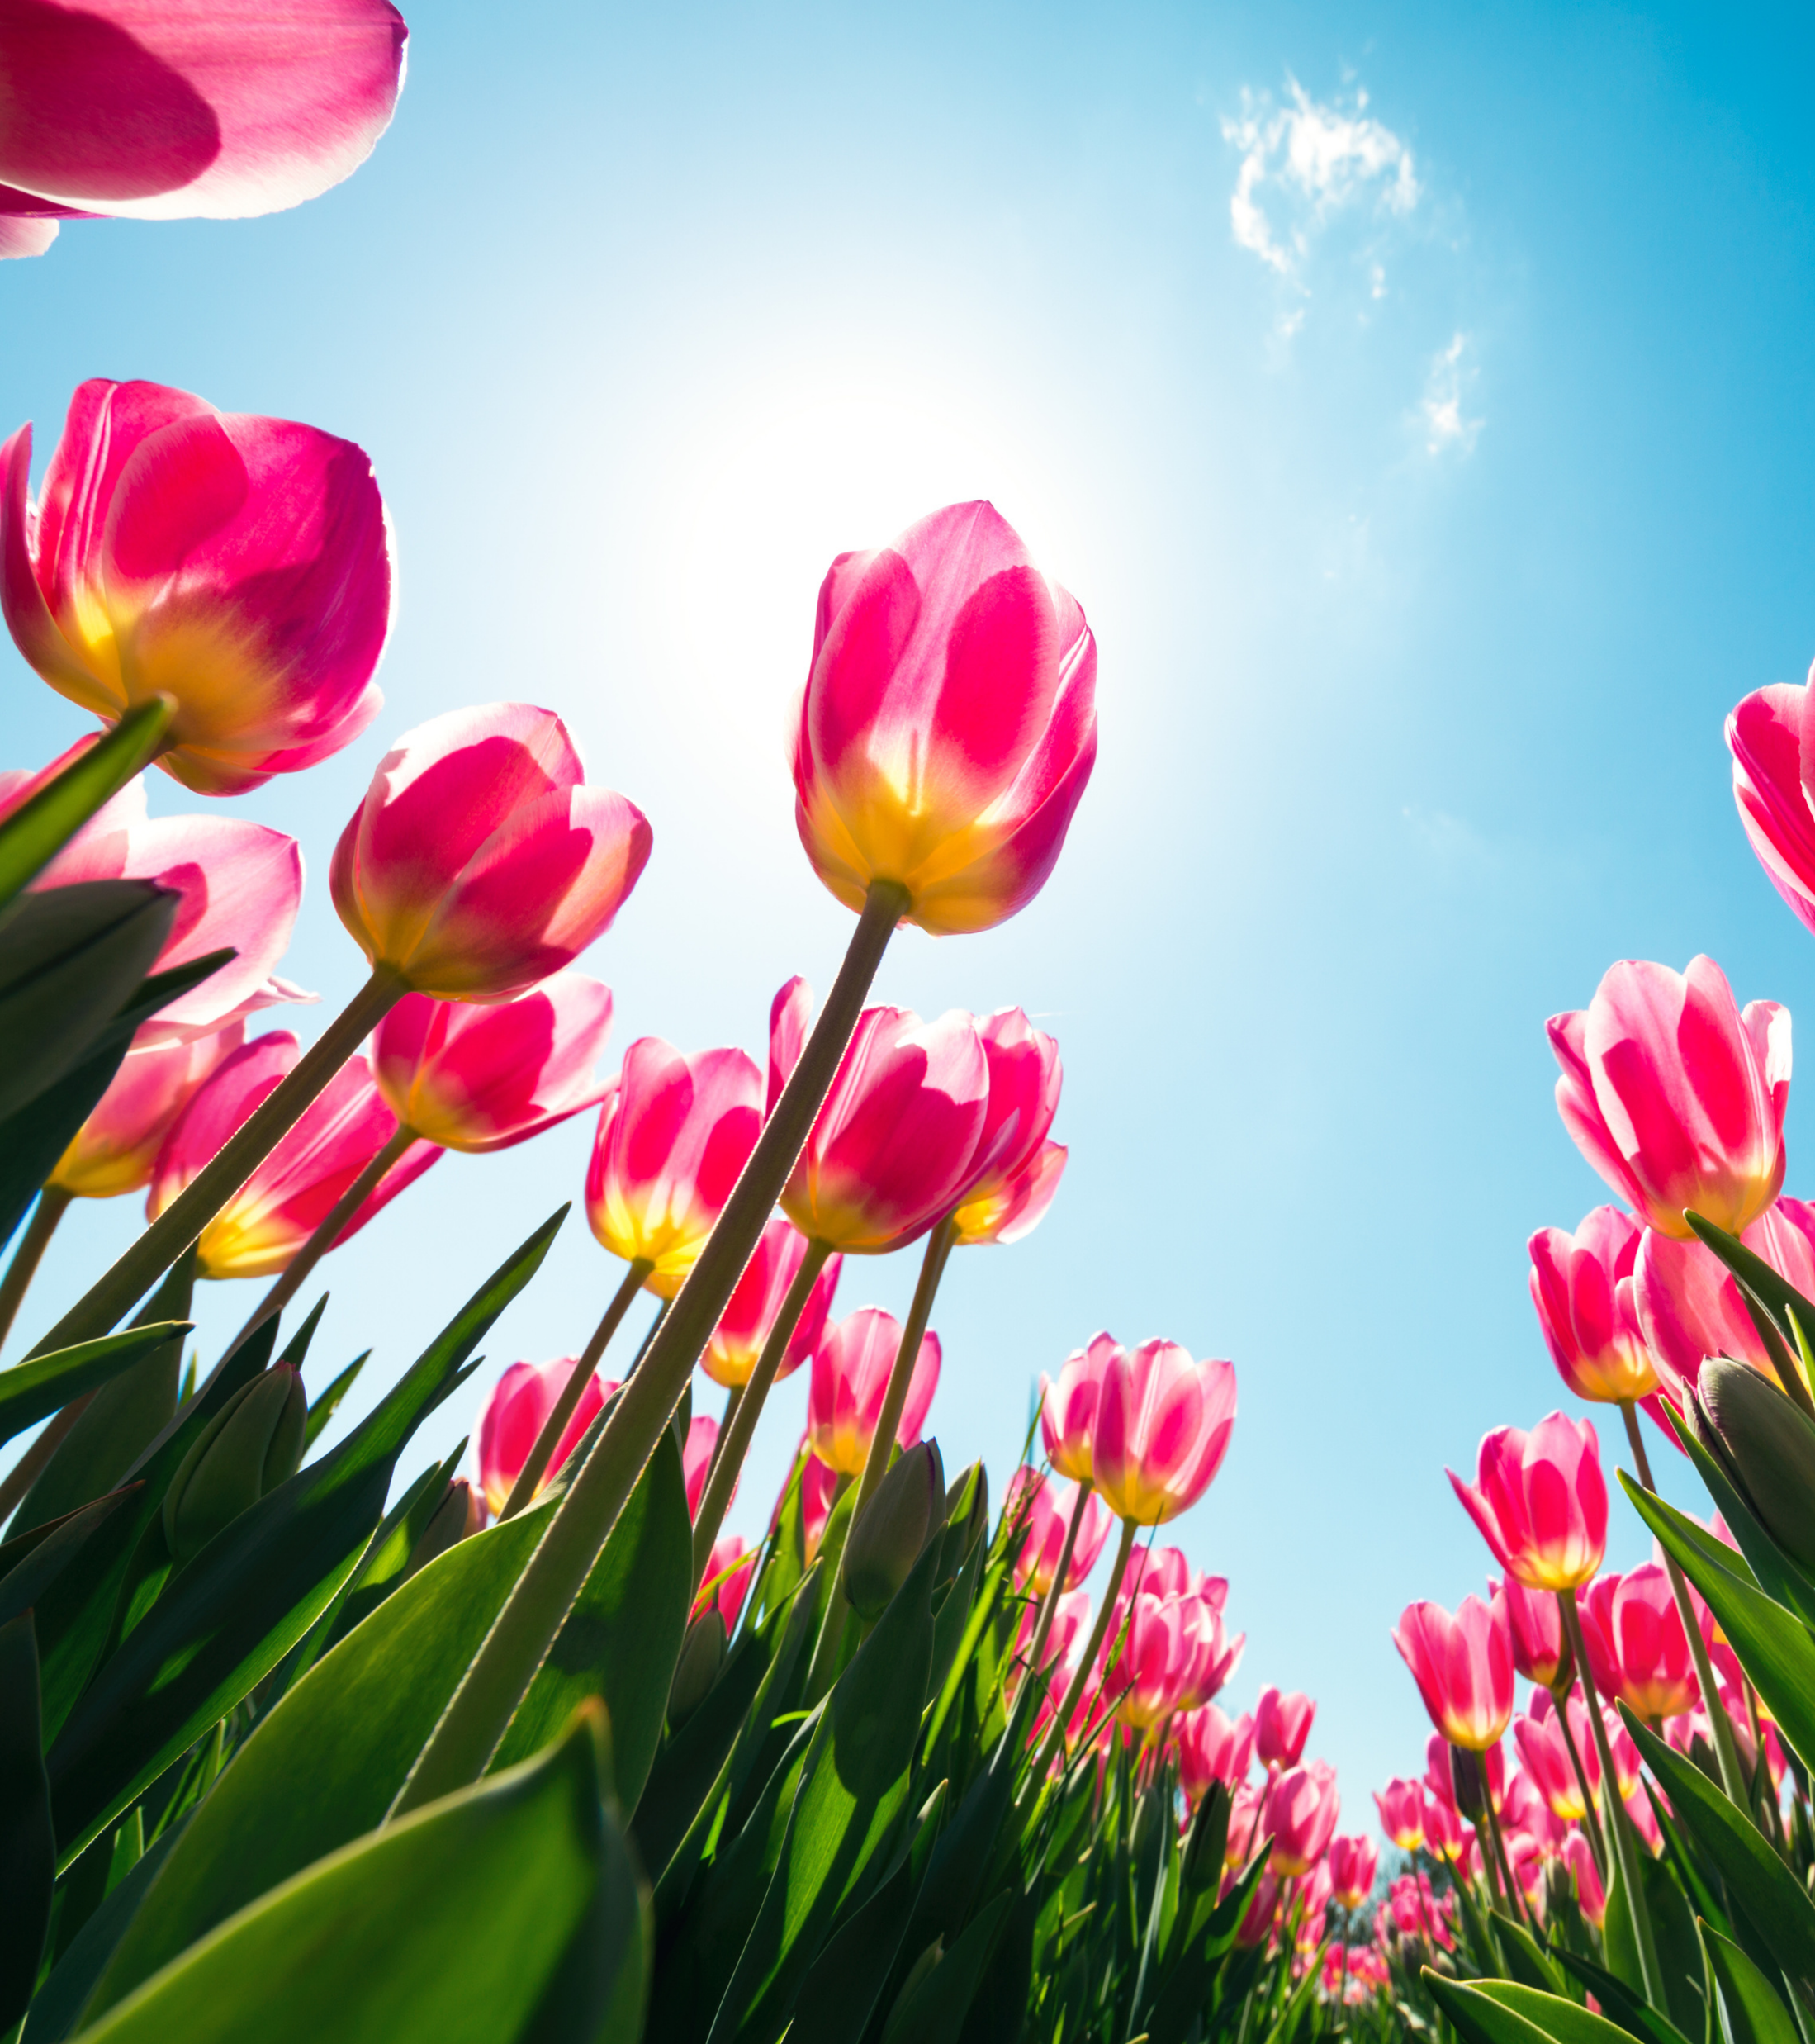

Year 7 Spring Term

Slide 2
Year 7 Overview
Aspirational outcomes for year 7 based on Bloom’s Affective Taxonomy (Anderson & Krathwohl, 2009). Receiving: Has an awareness of individual emotional differences, shows a willingness to hear and learn about emotional diversity.
Progression in learning aims from self, to others, to community
Responding to one’s emotions with curiosity
Exploring our emotional self
Recognising the uniqueness of one’s emotions
Having a growth mindset about our emotional selves
Understanding emotional energy
Identifying and using stress-management strategies
Learning to express one’s emotional needs
Developing an awareness that different people express and experience emotions differently
Engaging in adult-led conflict resolution
Demonstrating curiosity and open-mindedness

Slide 3
Spring Term | Aims | Objective | Activity * Requires printing and/or photocopying
Week 1 | Revisiting Prior Learning | Reconnecting through colour | Mr Men and Little Miss
Week 2 | Having a growth mindset about our emotional selves | Understanding how a different lens can change our responses | Colour Context
Week 3 |  | Discovering different perspectives | Optics
Week 4 |  | Exploring our assumptions | Reaction Reel
Week 5 | Understanding emotional energy | Exploring the idea of emotional energy | Emotional Energy Videos
Week 6 |  | Understanding one’s own emotional energy | Emotional Energy Sheet*
Week 7 |  | Identifying how to increase one’s emotional energy | Charging My Emotional Energy Poster
Week 8 | Identifying and using stress-management strategies | Exploring breathing techniques for self-regulation | Rainbow Breathing
Week 9 |  | Exploring grounding techniques for self-regulation | Colour Visualising
Week 10 |  | Reflecting on our toolkit for self-regulation | Revisiting the emotional energy poster

Slide 4
Year 7 Spring Term Week 1
Learning Objective: Reconnecting through colour | Activity: Mr Men and Little Miss
Instructions: Ask the students to share anything they remember from term 1. Elicit how we used colour last term. Show the students the Mr Men and Little Miss slide. Invite them to think, pair, then share why each of the characters might be the colour they are. | Questions for engagement: Before activity What sessions do you recall from last term? How was colour used in these sessions? After activity Encourage class to share what they discussed in their pairs and to notice any similarities/differences with other pairs?
Resources:

Slide 5
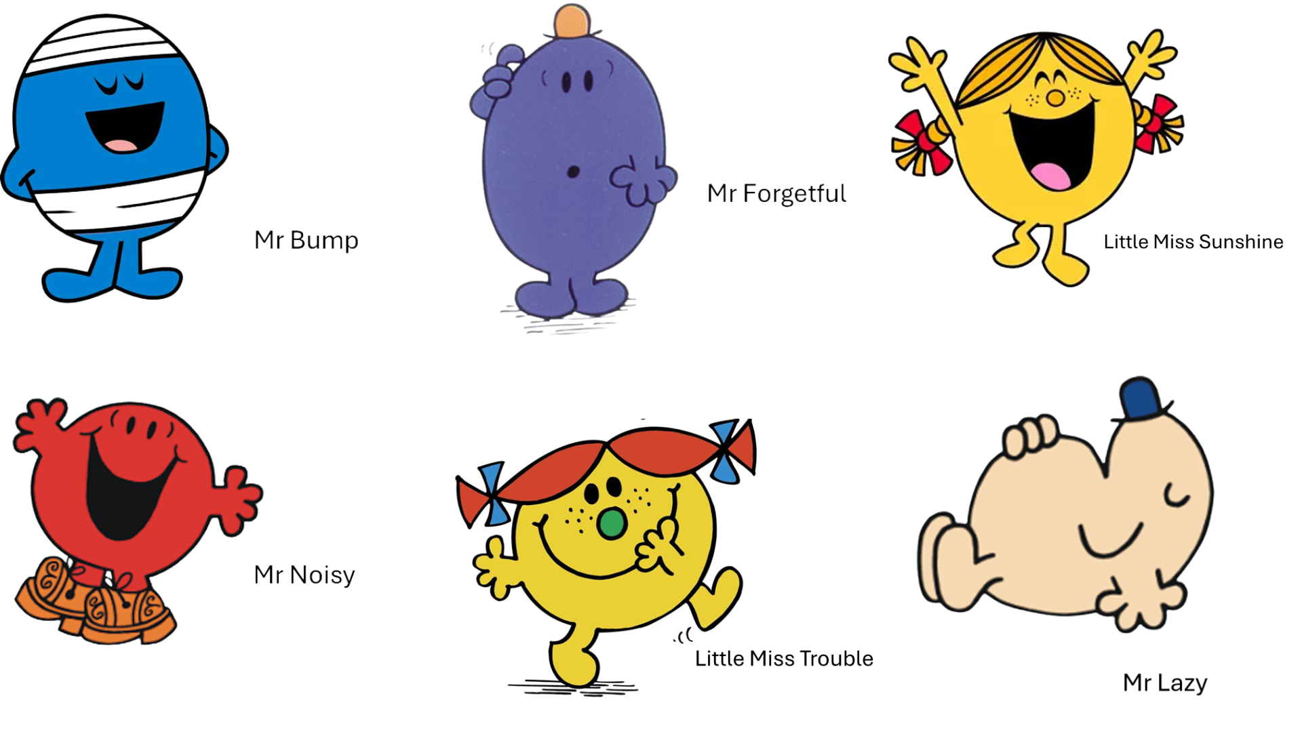

Slide 6
Year 7 Spring Term Week 2
Learning Objective: Understanding how a different lens can change our responses | Activity: Colour Context
Instructions: In the PowerPoint there are 6 different images in pairs, each image appears in two different tones. Show the first image and ask the students to think about their response to it. Then show the second image and ask the students to think about their response to it. Ask the students to discuss their responses to the first pair of images with their partners, then share as a whole class. Repeat for the remaining image pairs - you may not get through all the image pairs, that is fine, it is the discussion that matters. | Questions for engagement: What do you notice about your responses? Are there any similarities or differences between yours and your partner’s responses?
Resources:

Slide 7
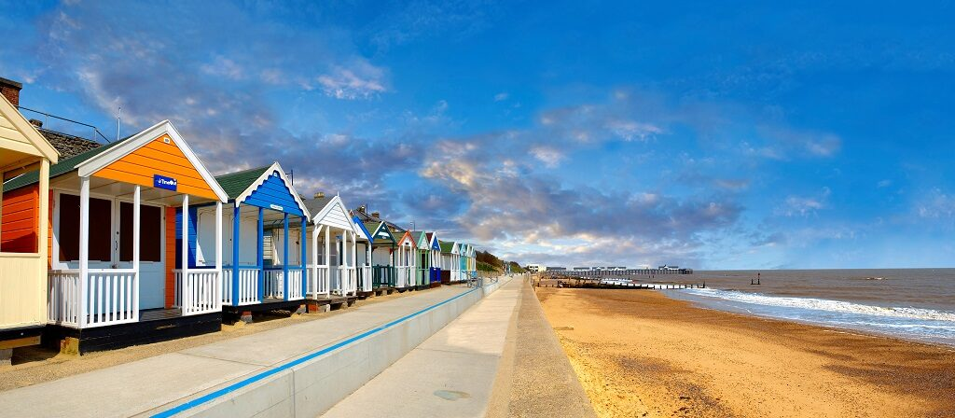

Slide 8
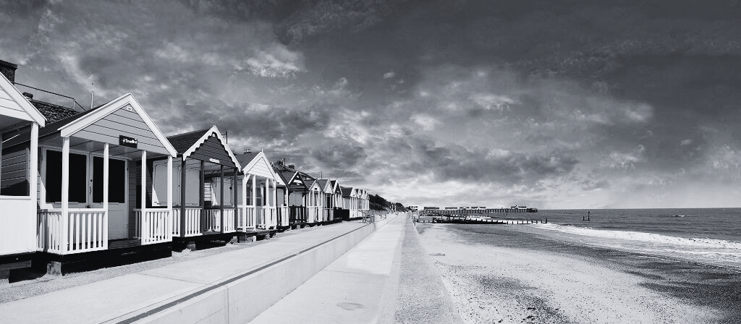

Slide 9
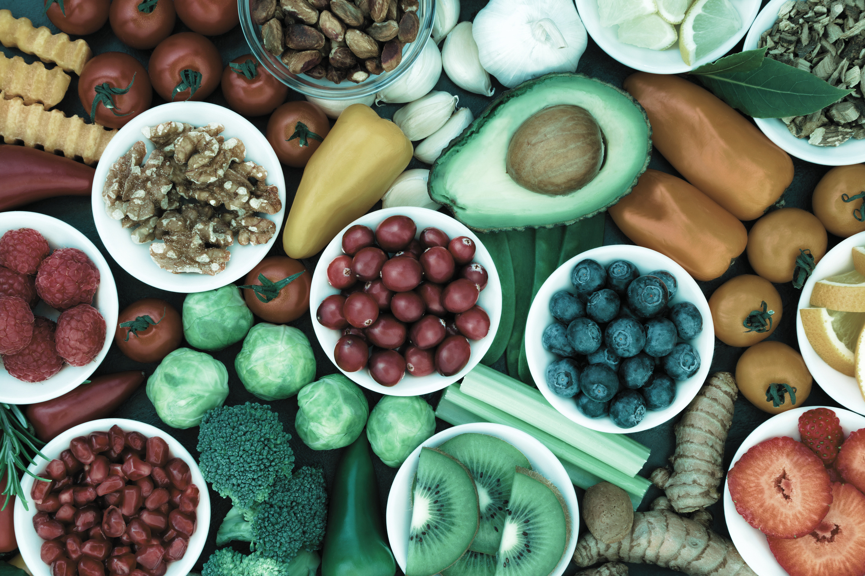

Slide 10
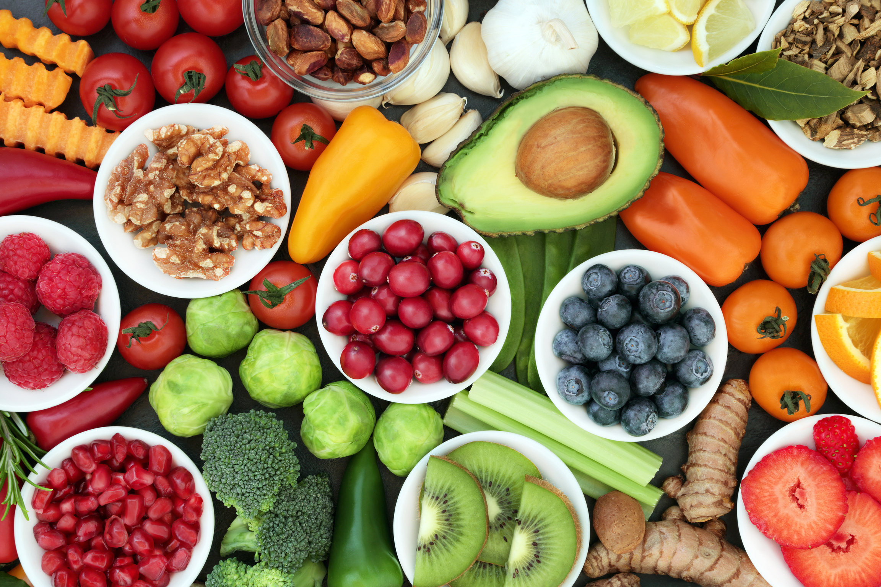

Slide 11
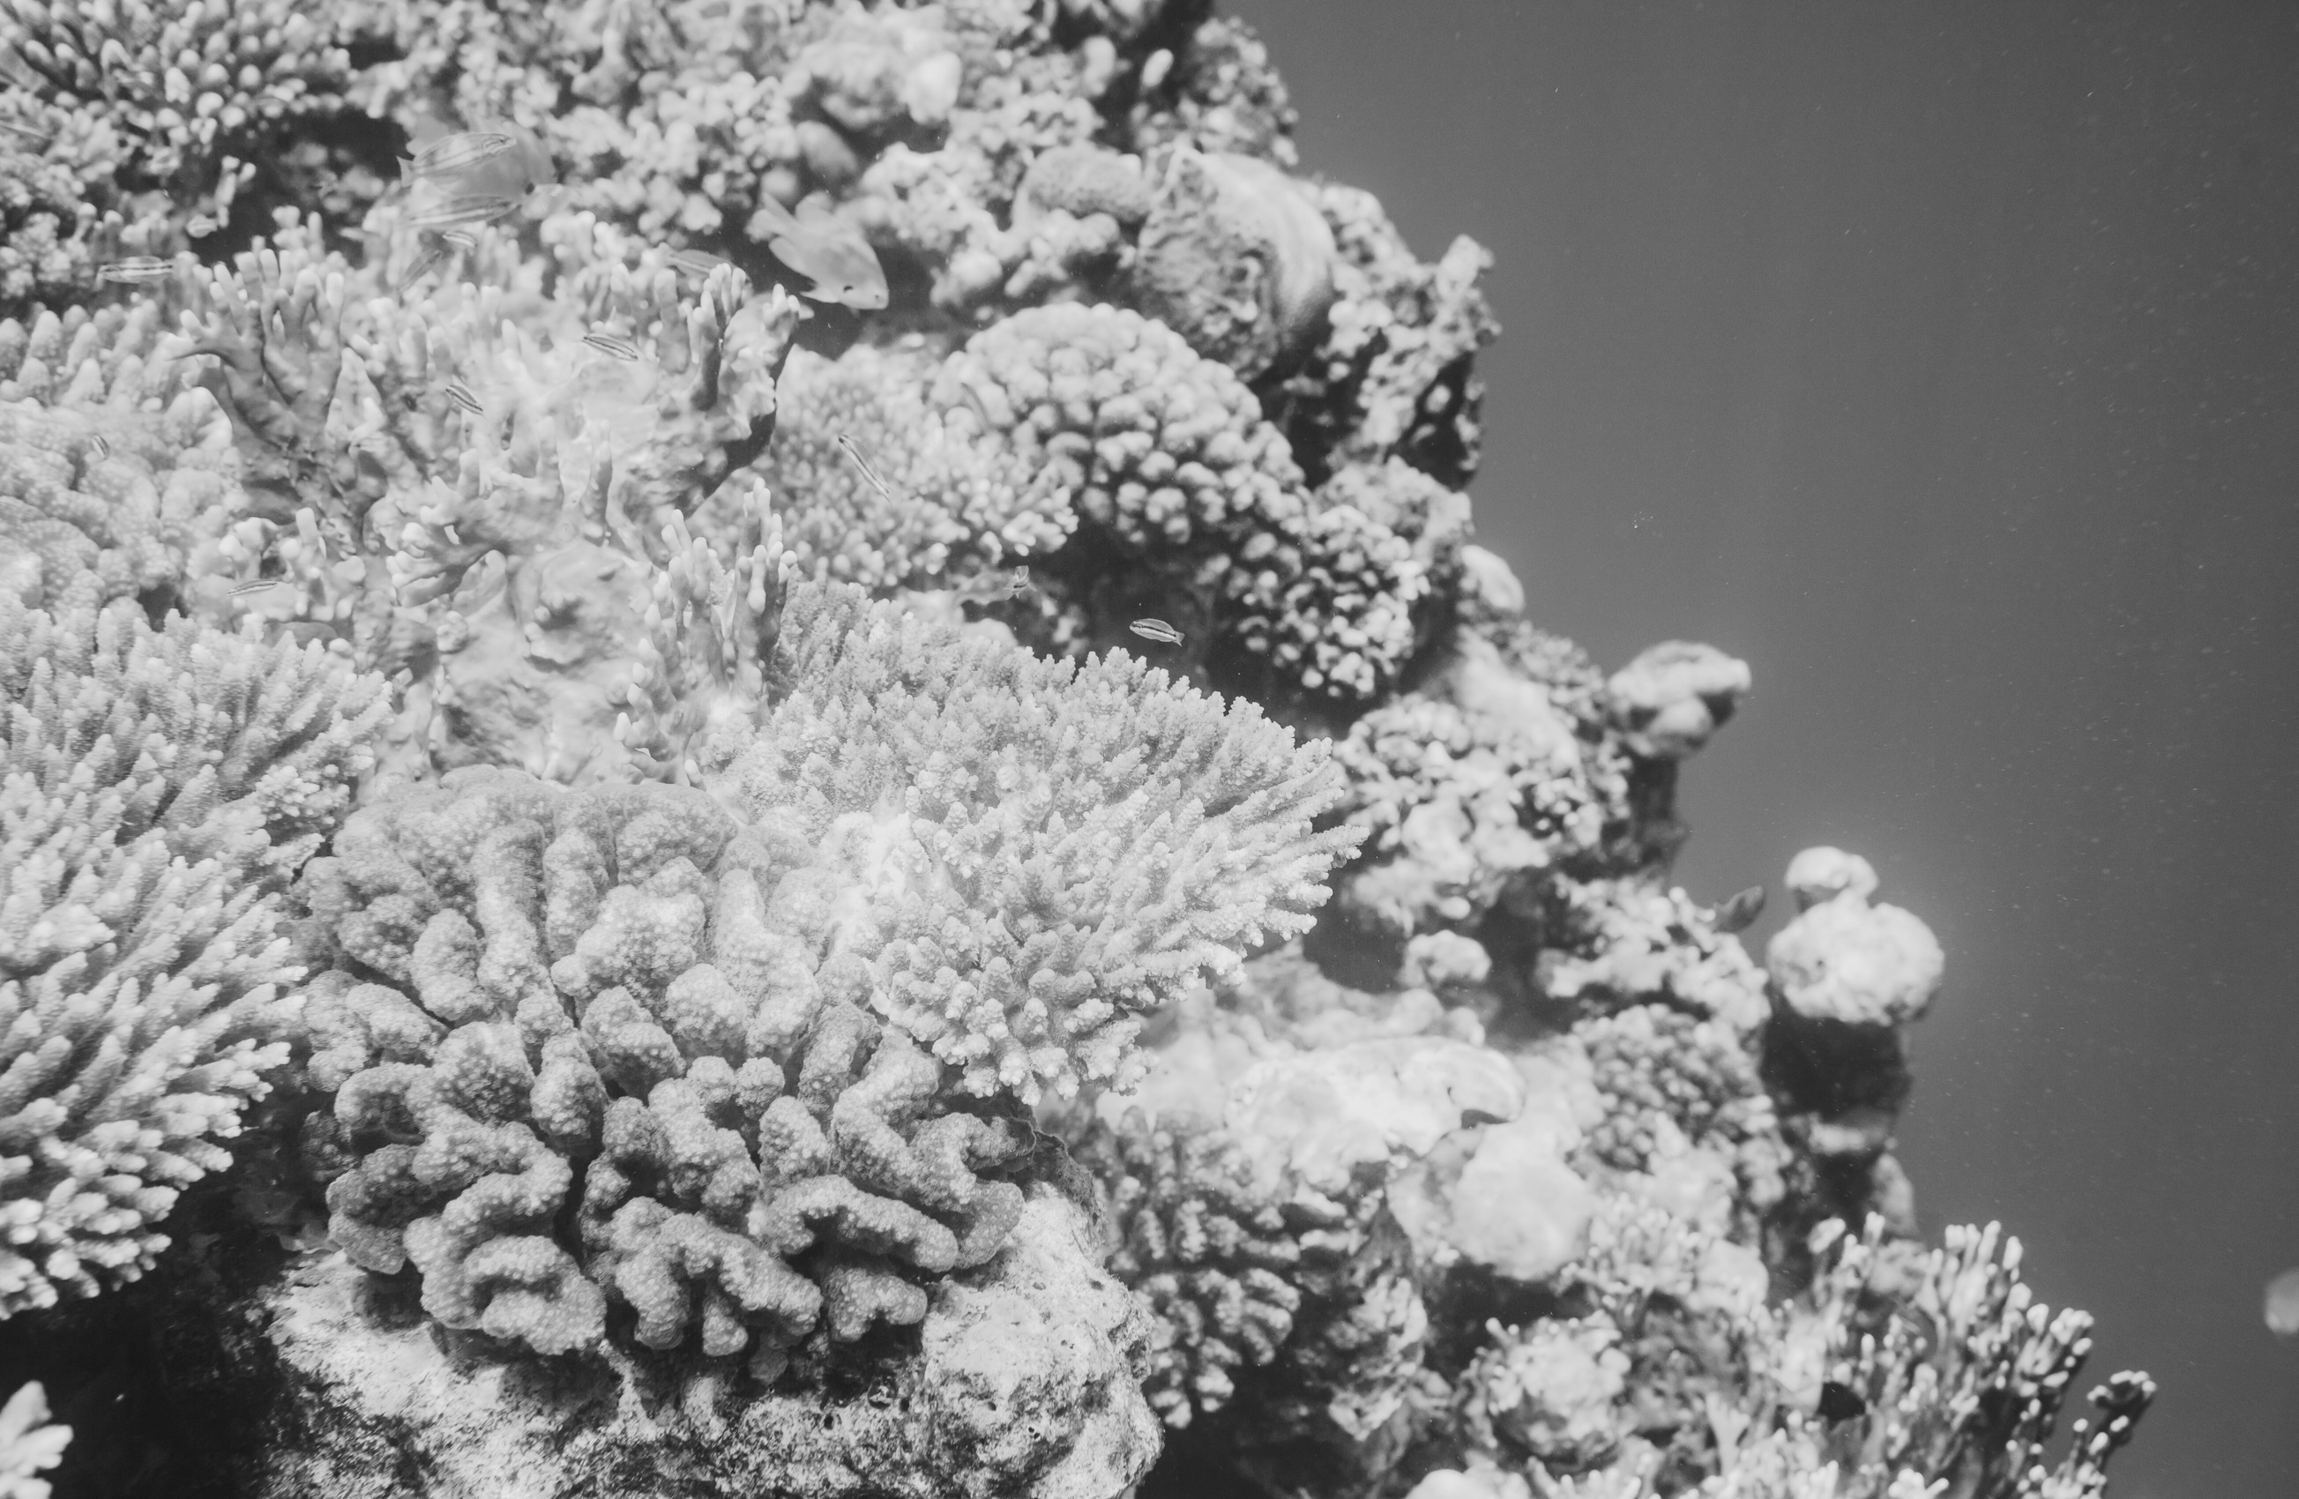

Slide 12
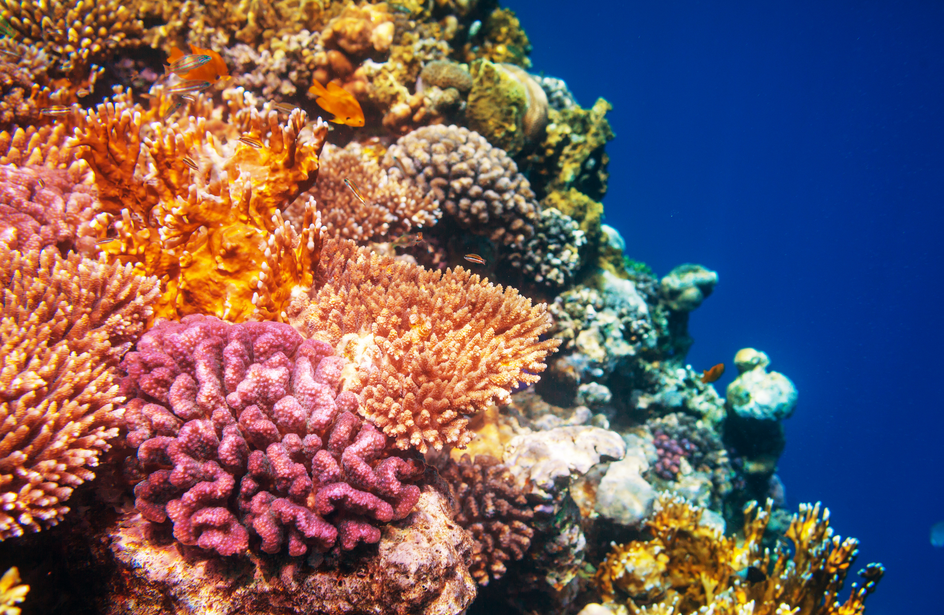

Slide 13
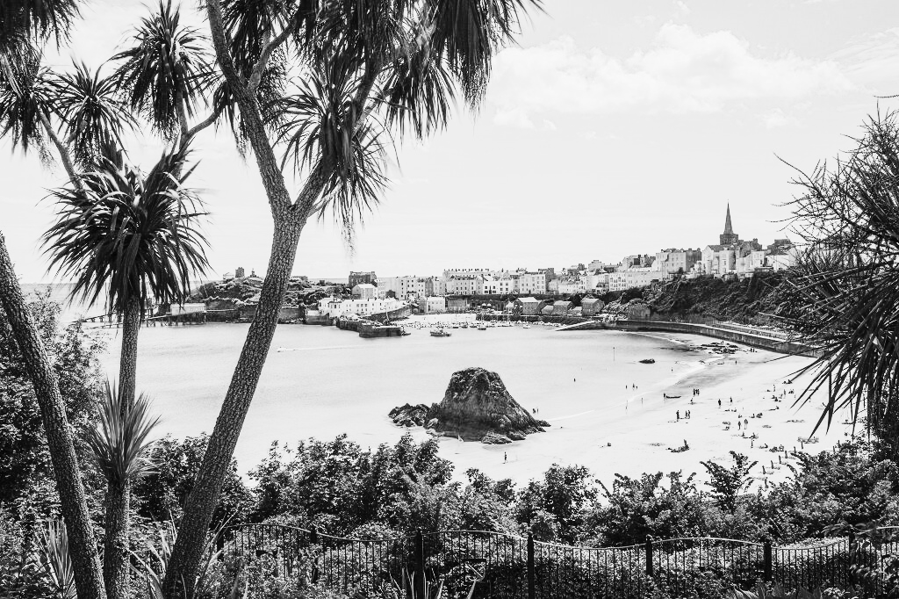

Slide 14
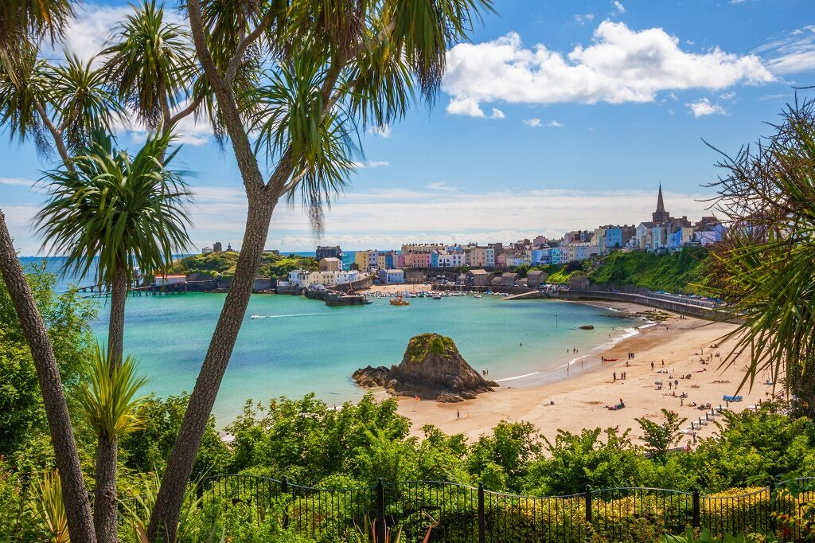

Slide 15
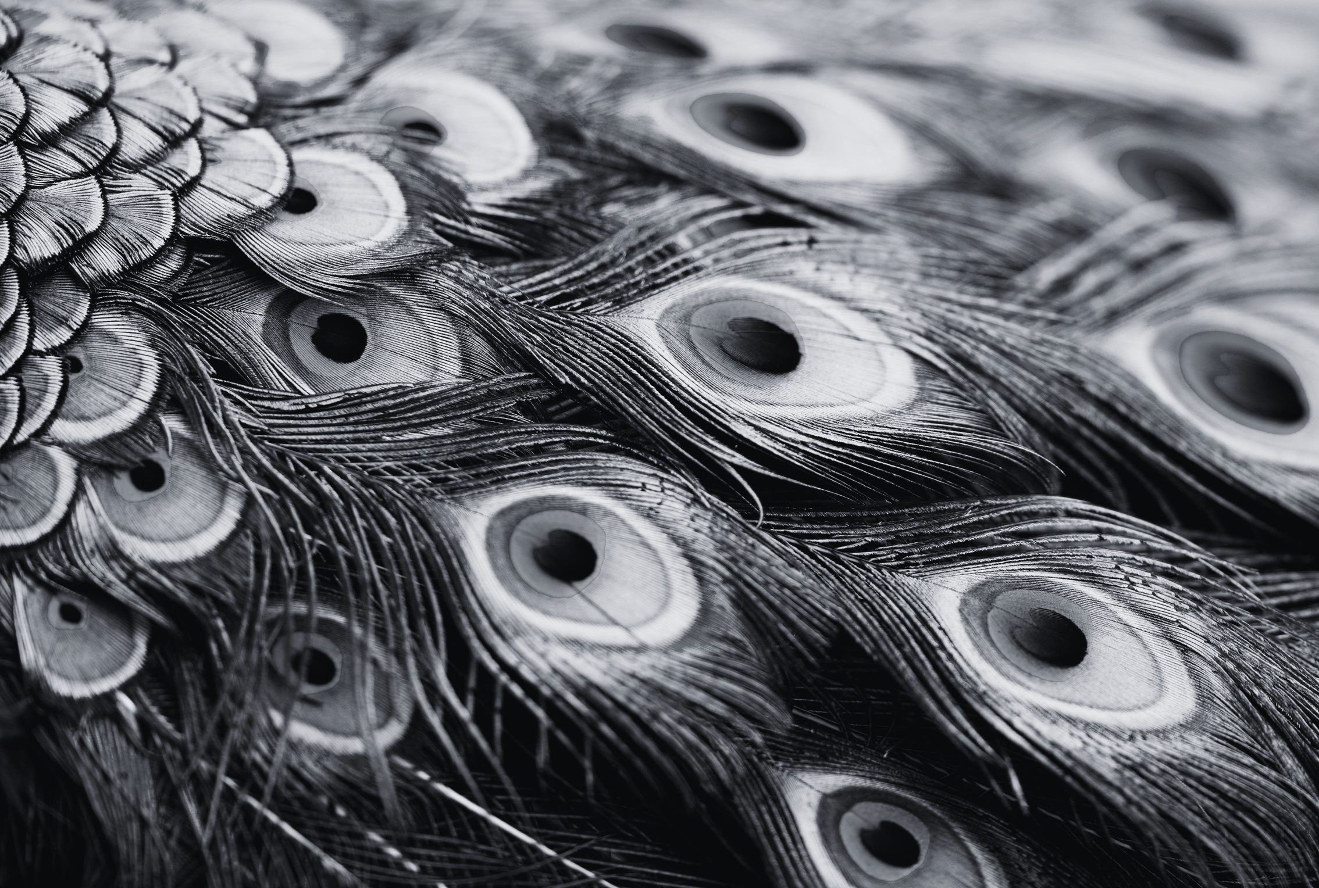

Slide 16
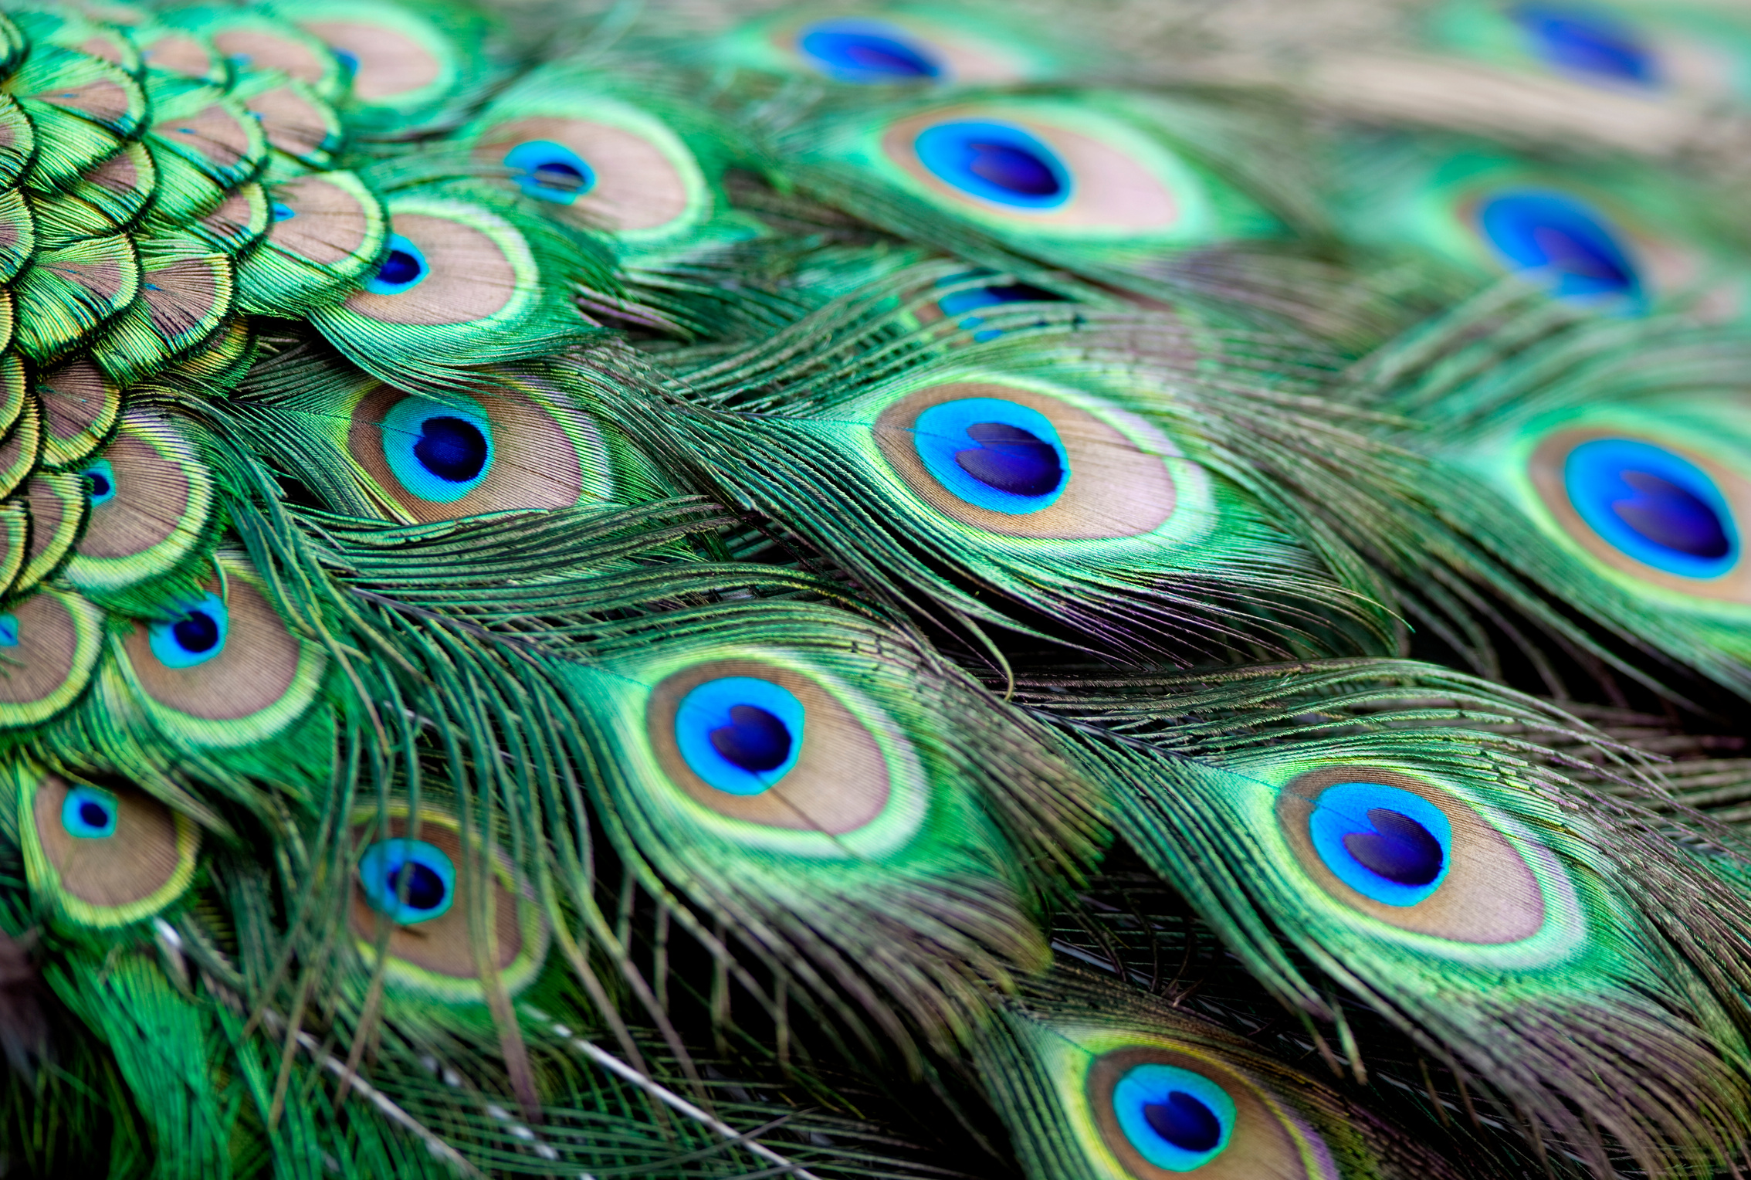

Slide 17


Slide 18


Slide 19
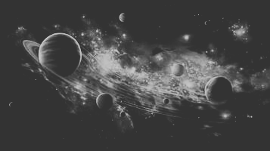

Slide 20


Slide 21
Year 7 Spring Term Week 3
Learning Objective: Discovering different perspectives | Activity: Optics
Instructions: For images 1-4: Show the optical illusion for 10 seconds. Then discuss as a class what everyone saw. Then show the same optical illusions for 30 seconds and invite the students to see if they can discover what their peers saw. Then for the last 5 minutes show them the magic eye and ask them to share what they see with a partner. Then discuss it as a class. You may or may not be able to see it, it can take some time, just reassure the class that this is about different perspectives, not right answers. | Questions for engagement: Image 1 do you see two people speaking or a candle stick? Image 2 is the image moving? How is moving? Image 3 what animals do you see? (duck or rabbit) Image 4 what colour is the dress? Image 5 what 3D image do you see?
Resources:

Slide 22

1

Slide 23
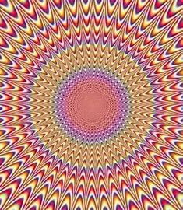
2

Slide 24
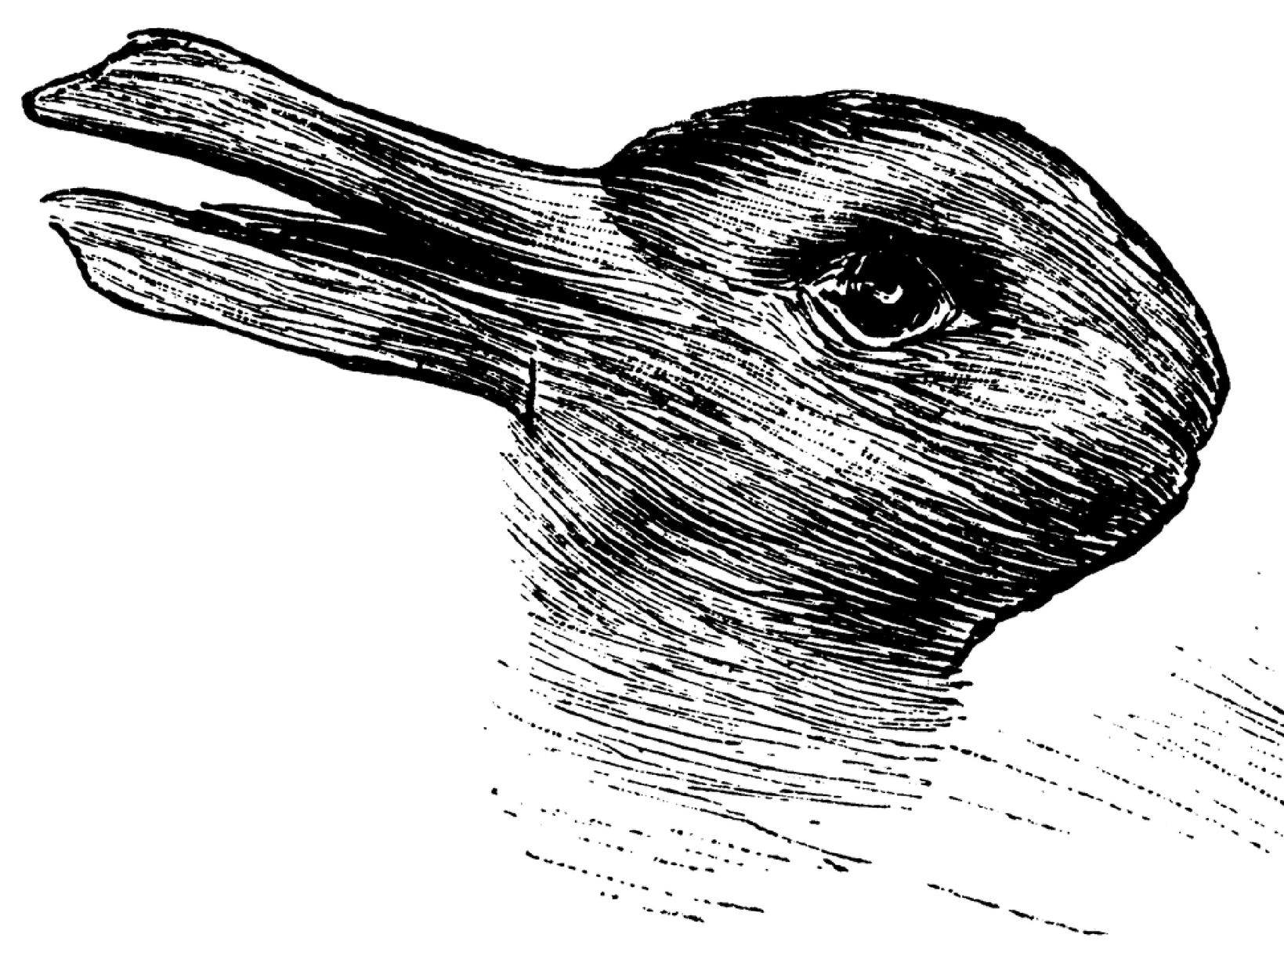
3

Slide 25
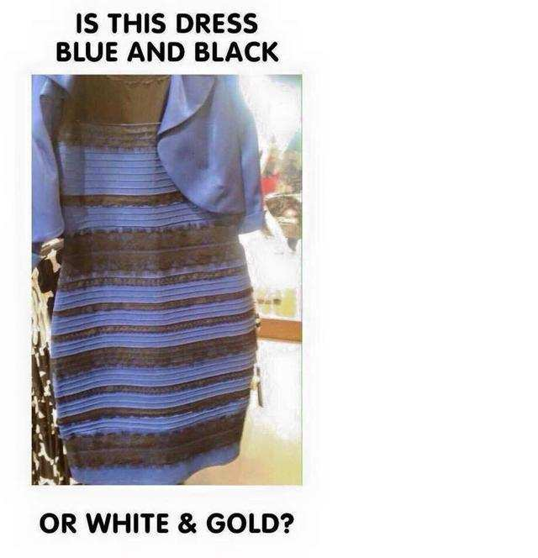
4

Slide 26
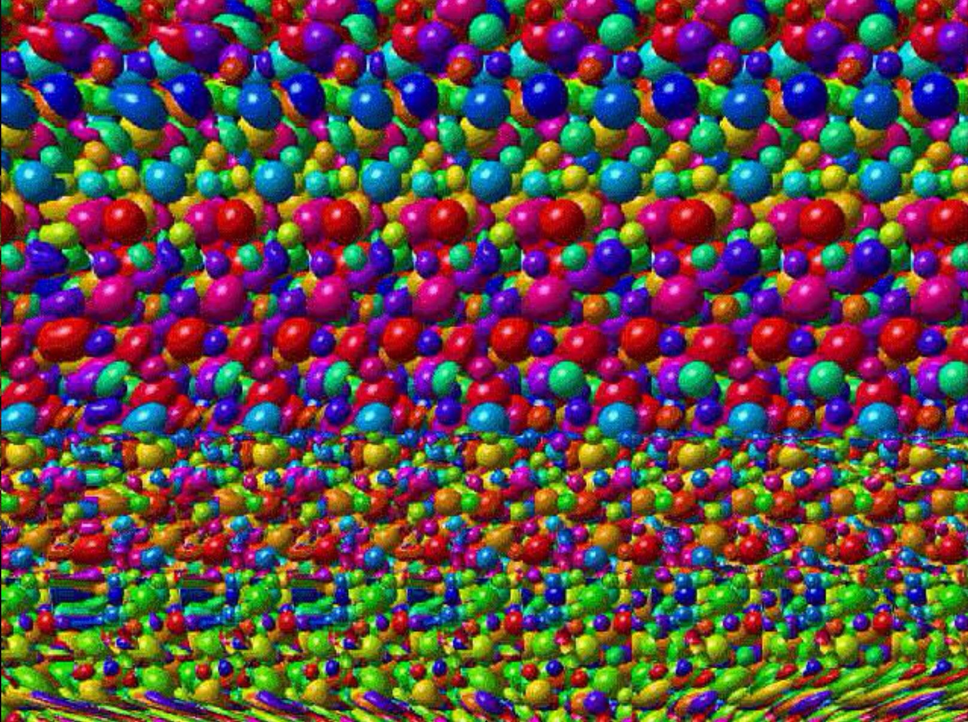
5

Slide 27
Year 7 Spring Term Week 4
Learning Objective: Discovering different perspectives | Activity: Reaction Reel
Instructions: Explain that they will be shown a cropped image, followed by the full image which explains the context. Show each cropped image, then invite the students to hold up, or point to a colour on their charts which reflects what they think the person might be feeling. Then show the full image on the following slide and ask the class to pick a colour to reflect how the person might now be feeling. Invite them to share if the colour they picked changed between the two images. | Questions for engagement: How did our perception of how the person was feeling shift between the cropped image and the whole image?
Resources: Colour charts

Slide 28
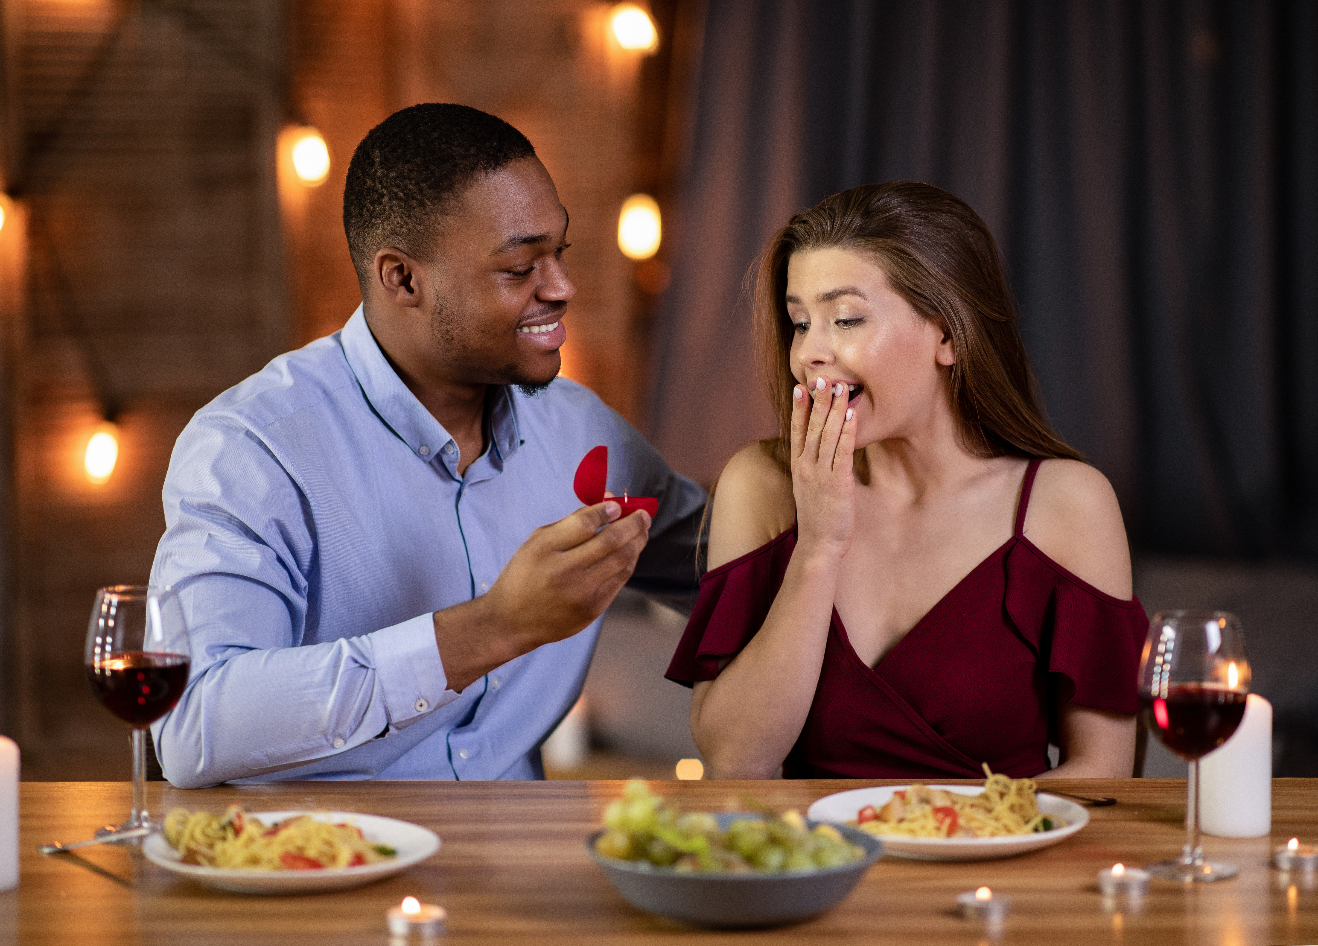

Slide 30
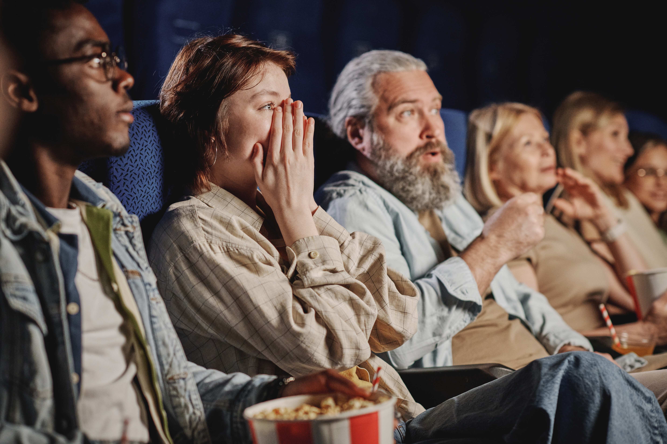

Slide 32
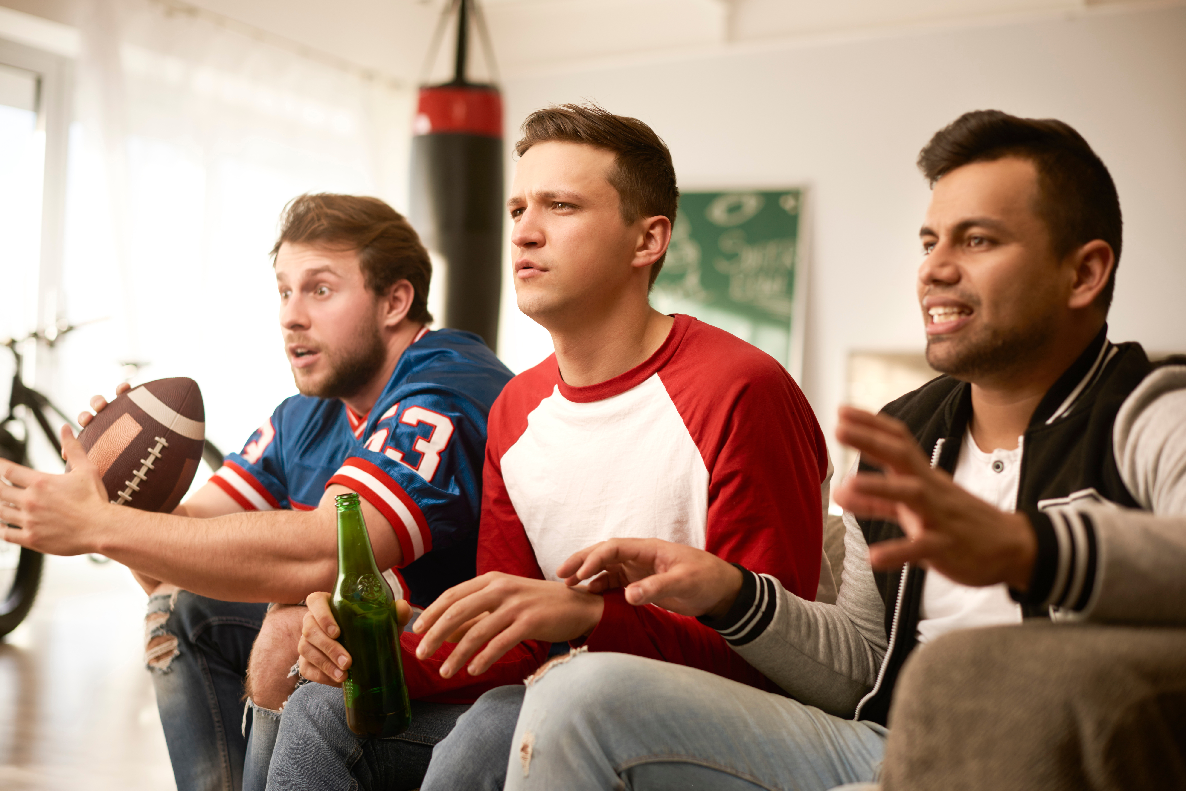

Slide 34
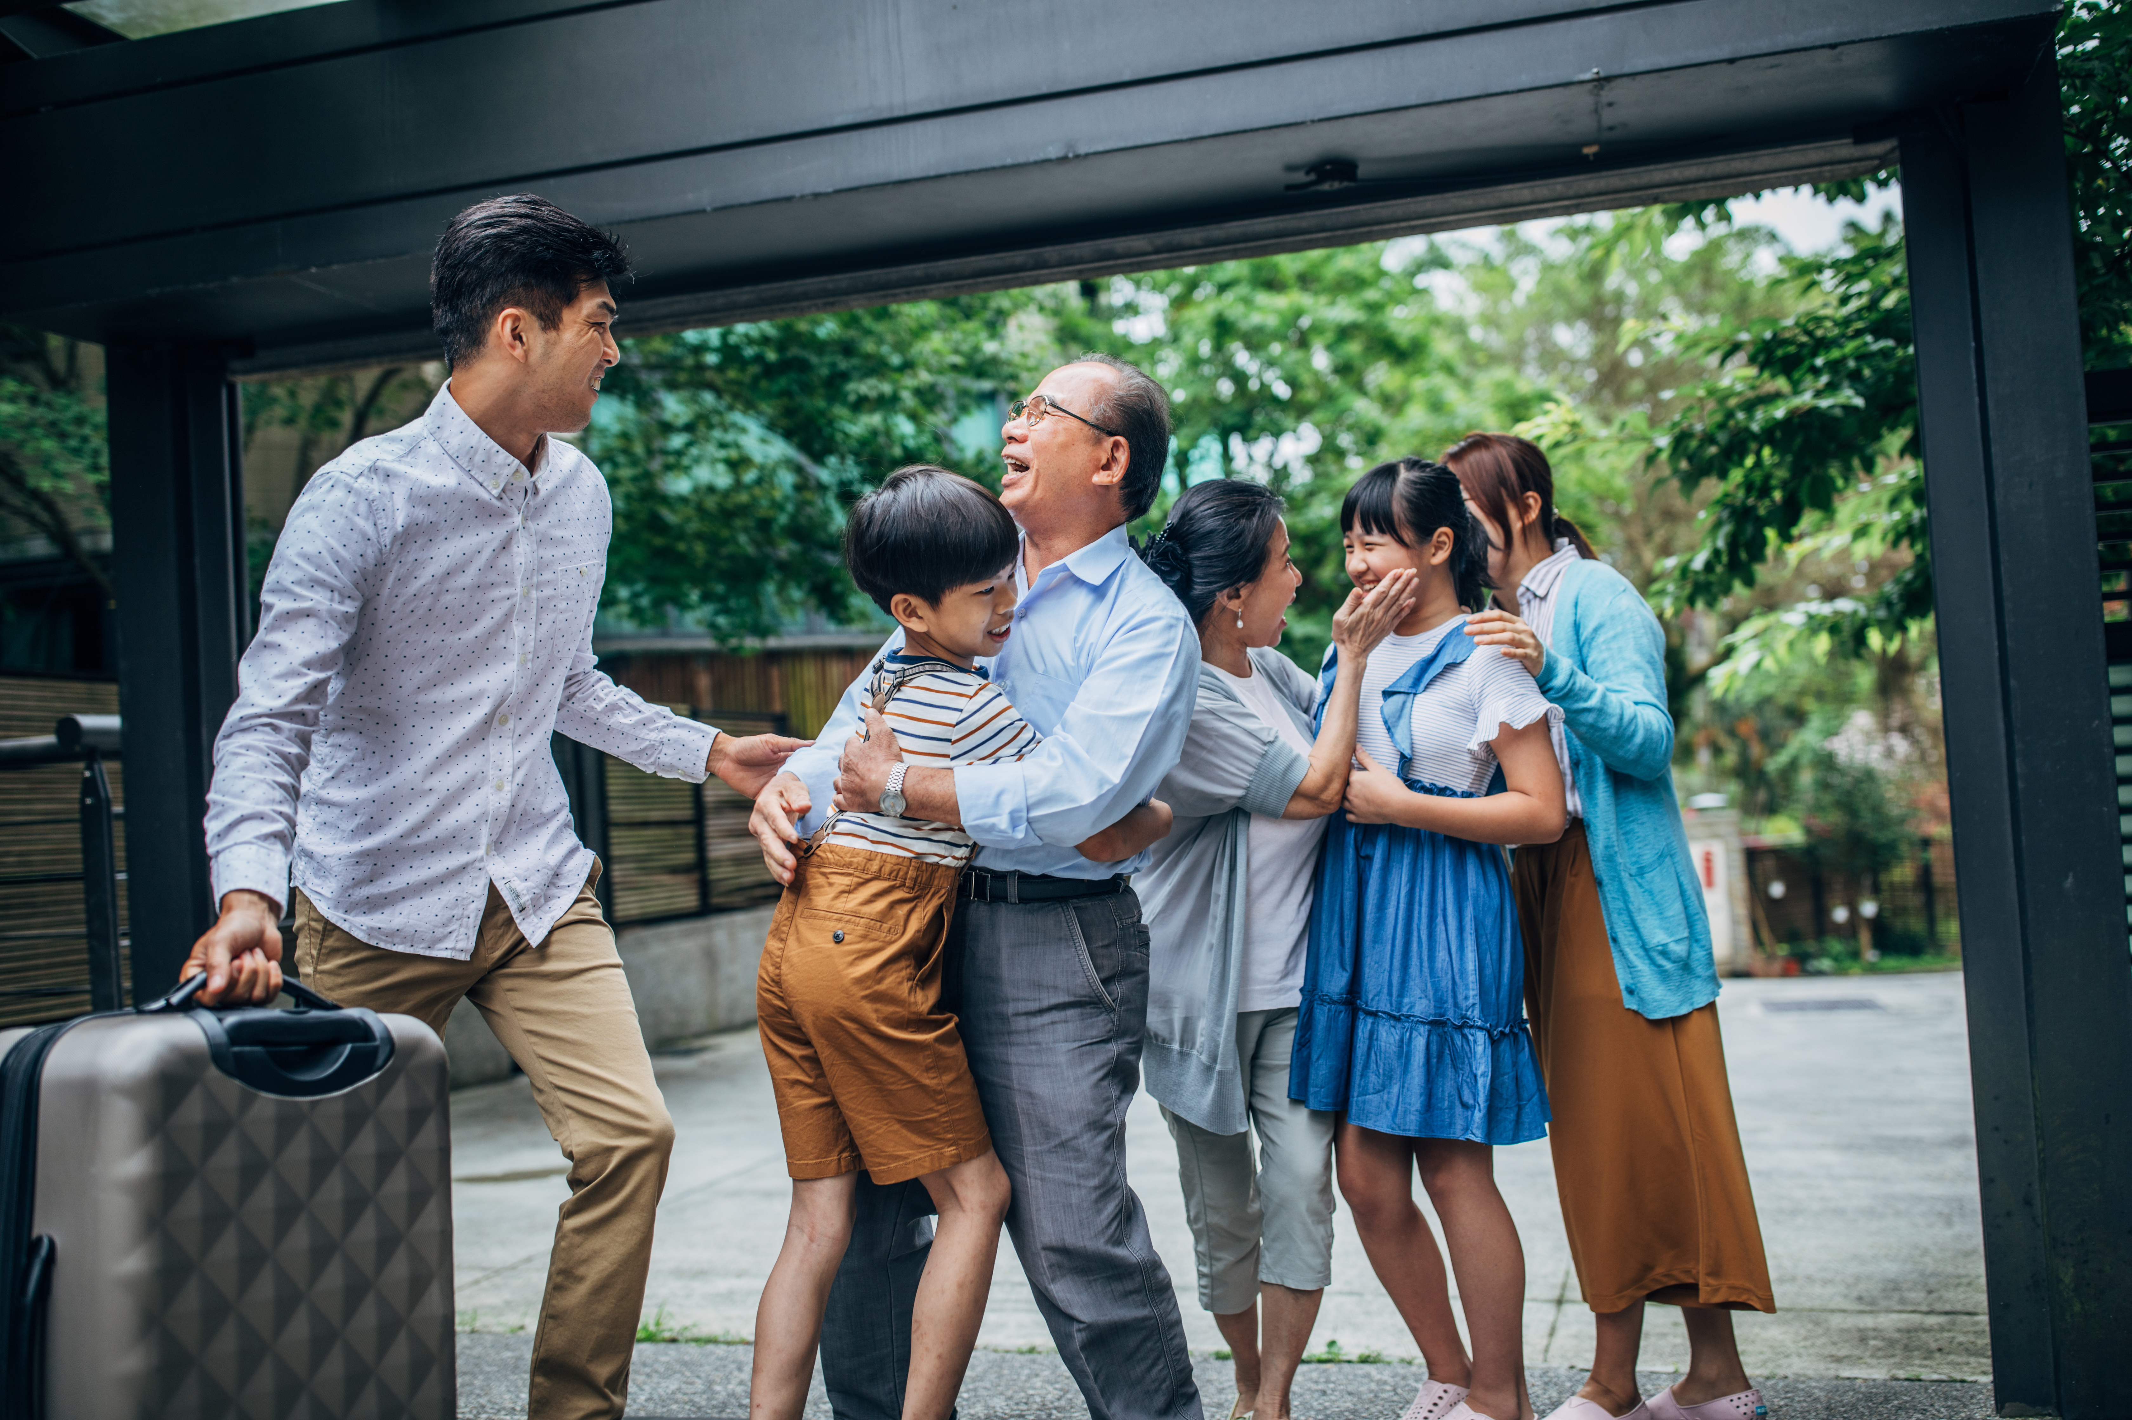

Slide 36
Year 7 Spring Term Week 5
Learning Objective: Exploring the idea of emotional energy | Activity: Emotional Energy Video
Instructions: Watch the first clip and invite the students to identify a colour which matches the emotions of the students in the exam room. Elicit the idea that our emotional energy levels can go up and down, just like our physical energy levels. Then watch the remaining video clips, and after each one, invite the students to identify a colour which reflects the emotional energy of the people in the video clips. Discuss as a class or think, pair, share. | Questions for engagement: How do you think the people are feeling? What is happening to their emotional energy levels?
Resources: Colour charts

Slide 37


Slide 38
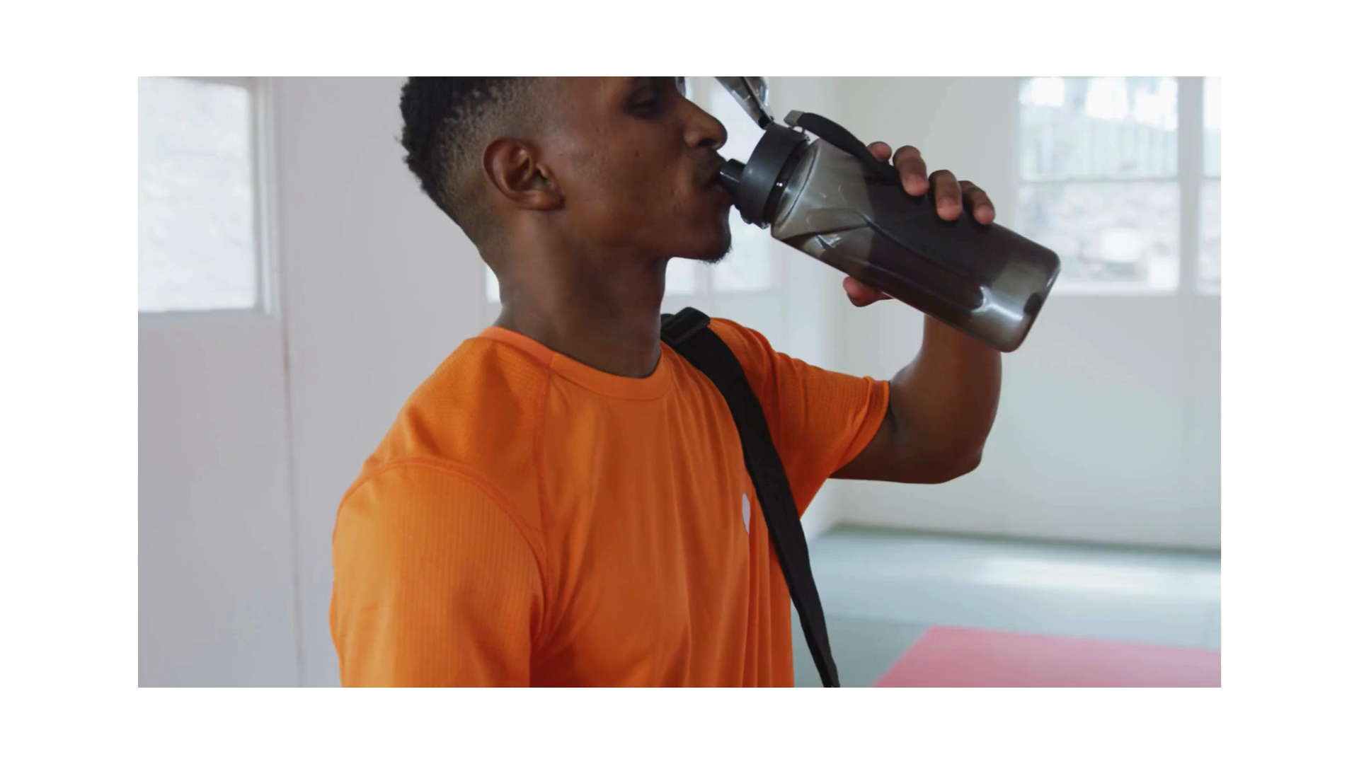

Slide 39
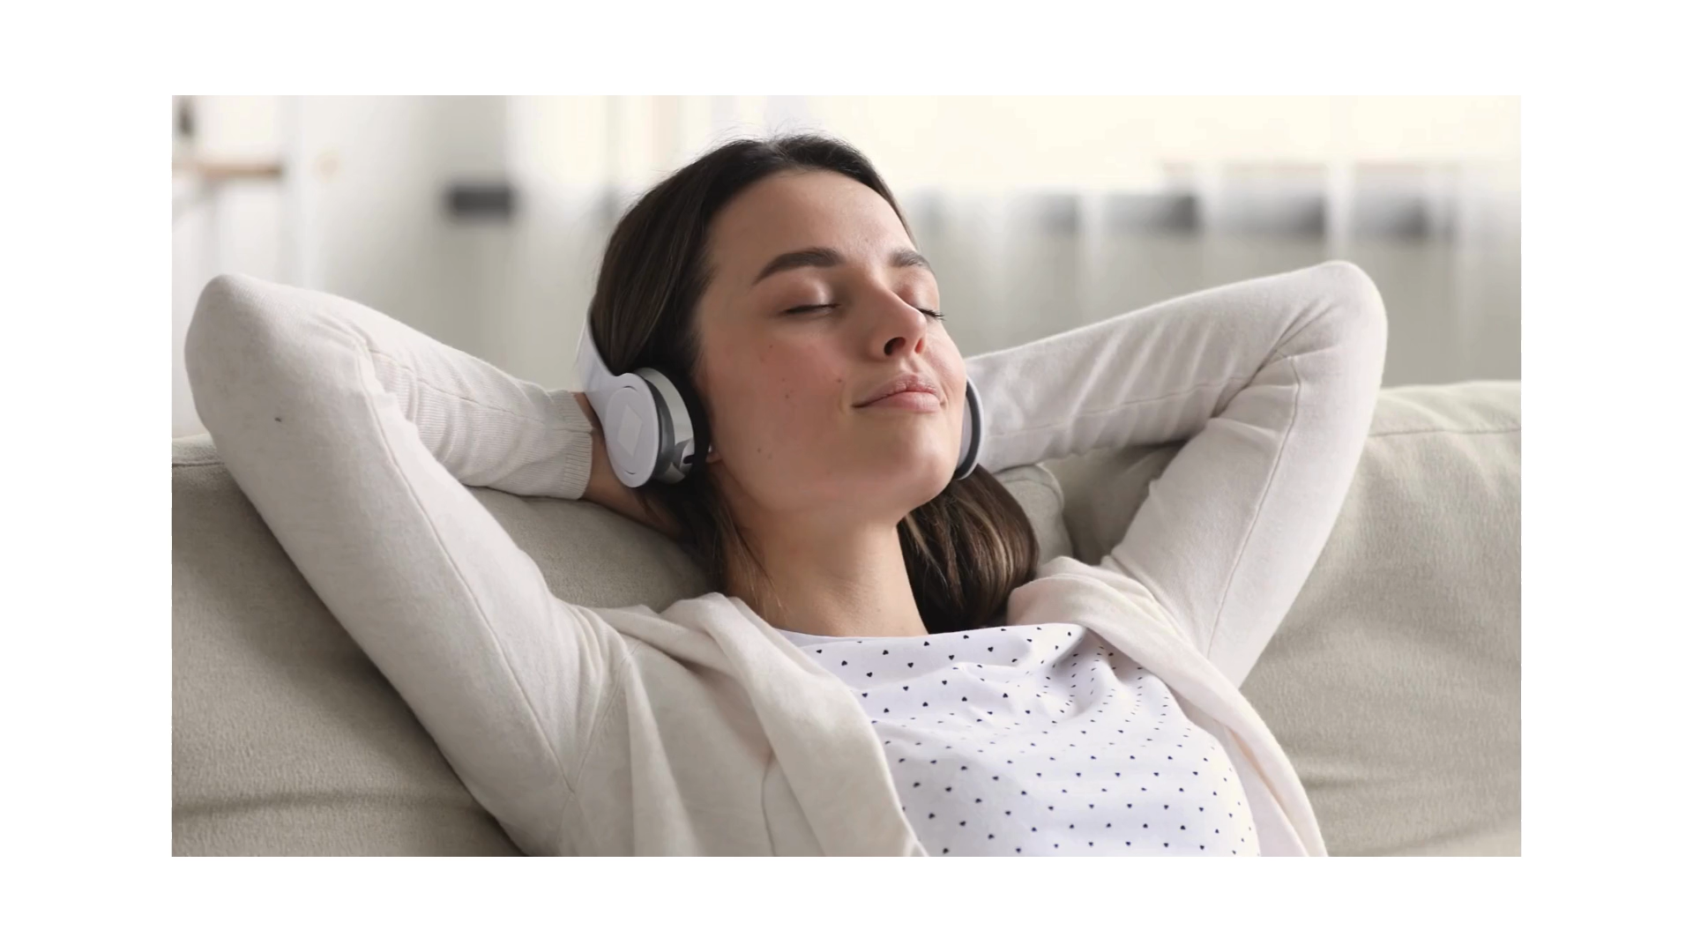

Slide 40


Slide 41
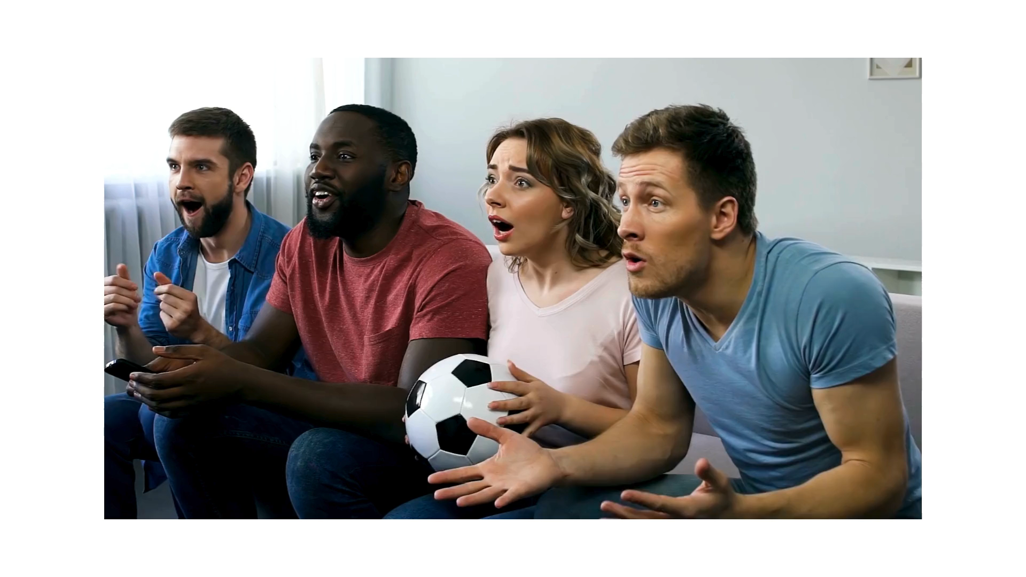

Slide 42
Year 7 Spring Term Week 6
Learning Objective: Understanding ones own emotional energy | Activity: Emotional Energy Sheet
Instructions: Ask the students to choose 2 coloured pencils, one to represent feeling emotionally charged, and one to represent feeling emotionally drained. Ask the students to colour the top two arrows on their sheets accordingly. Explain to the students that they have 6 pictures to consider. Each picture has an up arrow and a down arrow. For each picture, ask the students to colour the up arrow if they would find the activity emotionally charging, or the down arrow if they would find it emotionally draining. Discuss in pairs, then as a group. | Questions for engagement: Are there any activities which you could have coloured both arrows?
Resources: Colouring pencils Emotional energy 1 per student

Slide 43
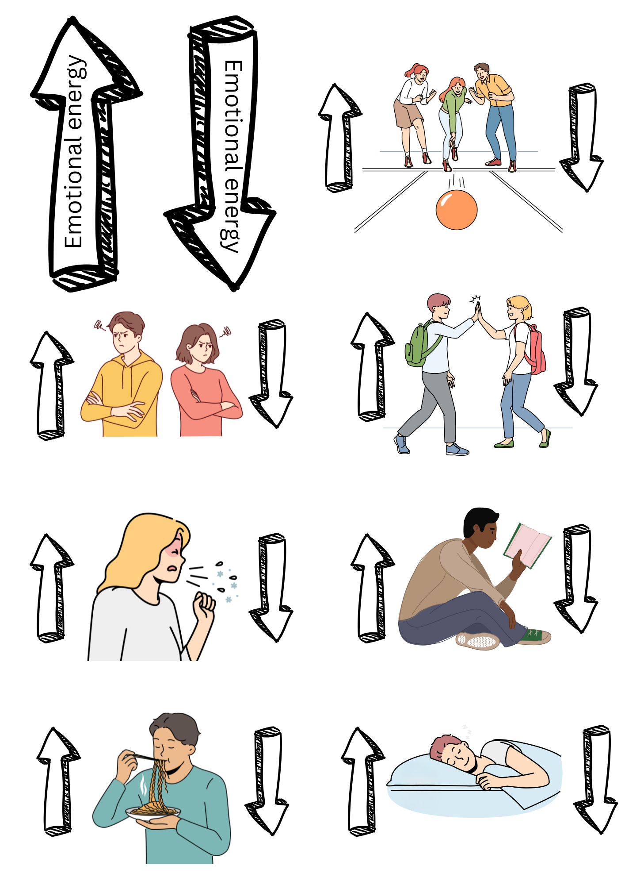

Slide 44
Year 7 Spring Term Week 7
Learning Objective: Identifying how to increase one’s emotional energy | Activity: Energiser Poster
Instructions: Show the students the example Charging My Emotional Energy Poster. Ask why some of these things might be on there. Ask students to design their own poster featuring the things that increase their emotional energy, they can include the ideas from the previous session and new ones. They can compare and discuss their posters with their peers. Once finished, collect the posters in as they will need them again in week 10. | Questions for engagement: Do we all find the same things energising? What might you find energising that someone else finds draining?
Resources: Paper Colouring pencils

Slide 45
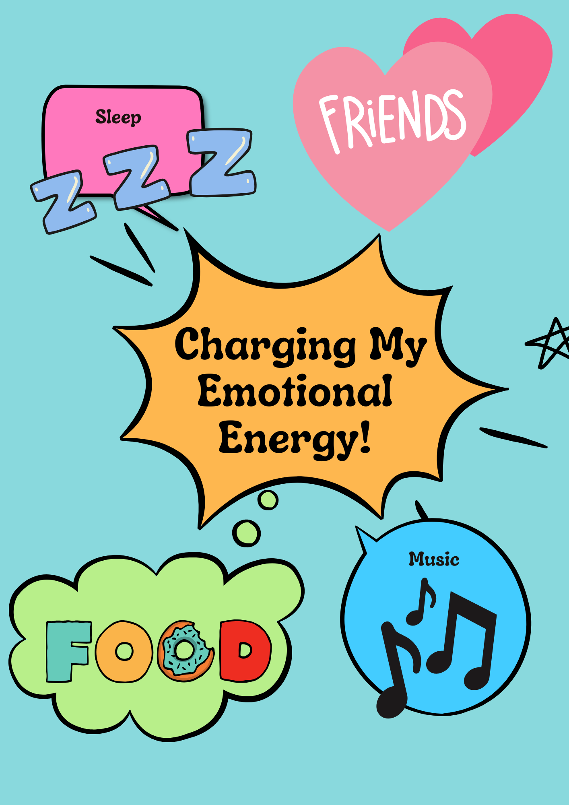

Slide 46
Year 7 Spring Term Week 8
Learning Objective: Exploring breathing techniques for self-regulation | Activity: Rainbow Breathing
Instructions: Show the rainbow slide. Ask students if anyone has done the rainbow breathing activity before. Ask the students to slowly breathe in as they follow the red arc and then slowly breathe out as they follow the orange arc. Continue until the rainbow is complete. Then invite students to draw their own rainbow, they can choose their own colours or use the standard rainbow colours. Encourage the students to practice their rainbow breathing using their rainbows. | Questions for engagement: How did the activity make you feel? Did you notice any difference before and after the breathing activity?
Resources: Paper Colouring pencils

Slide 47
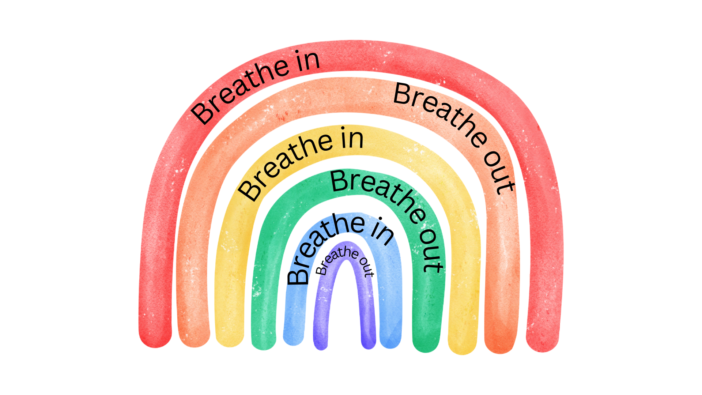

Slide 48
Year 7 Spring Term Week 9
Learning Objective: Exploring grounding techniques for self-regulation | Activity: Colour Visualising
Instructions: Ask the students if any of them already know any grounding techniques and invite them to share. Introduce the colour grounding technique on the slide and invite them to do the activity on their own. Share and reflect together on how they found the activity. | Questions for engagement: How were you feeling before the activity? How did you feel after the activity? Did you notice any benefits from doing it?
Resources:

Slide 49
Look around you and notice:
5 blue things
4 green things
3 red things
2 yellow things
1 thing you can see that is your favourite colour.

Slide 50
Year 7 Spring Term Week 10
Learning Objective: Reflecting on our toolkit for self-regulation | Activity: Revisiting the emotional energy poster
Instructions: Hand the emotional energy posters back out. Ask the students to look at their posters and consider what they have found useful. Ask them to think about the previous 2 sessions on regulation and ask them if they would like to add anything to their posters and give them time to edit or remake their posters if they want to. Once finished asked them to do think with a partner about any times that they have used, or could have used, the strategies on their posters. | Questions for engagement: Have you tried any of your strategies this term? How did they help? (it could be at home, at school or anywhere else). What might you try next?
Resources: Emotional Energy Posters from week 7

Slide 51
Rainbow Breathing

