Slide 1
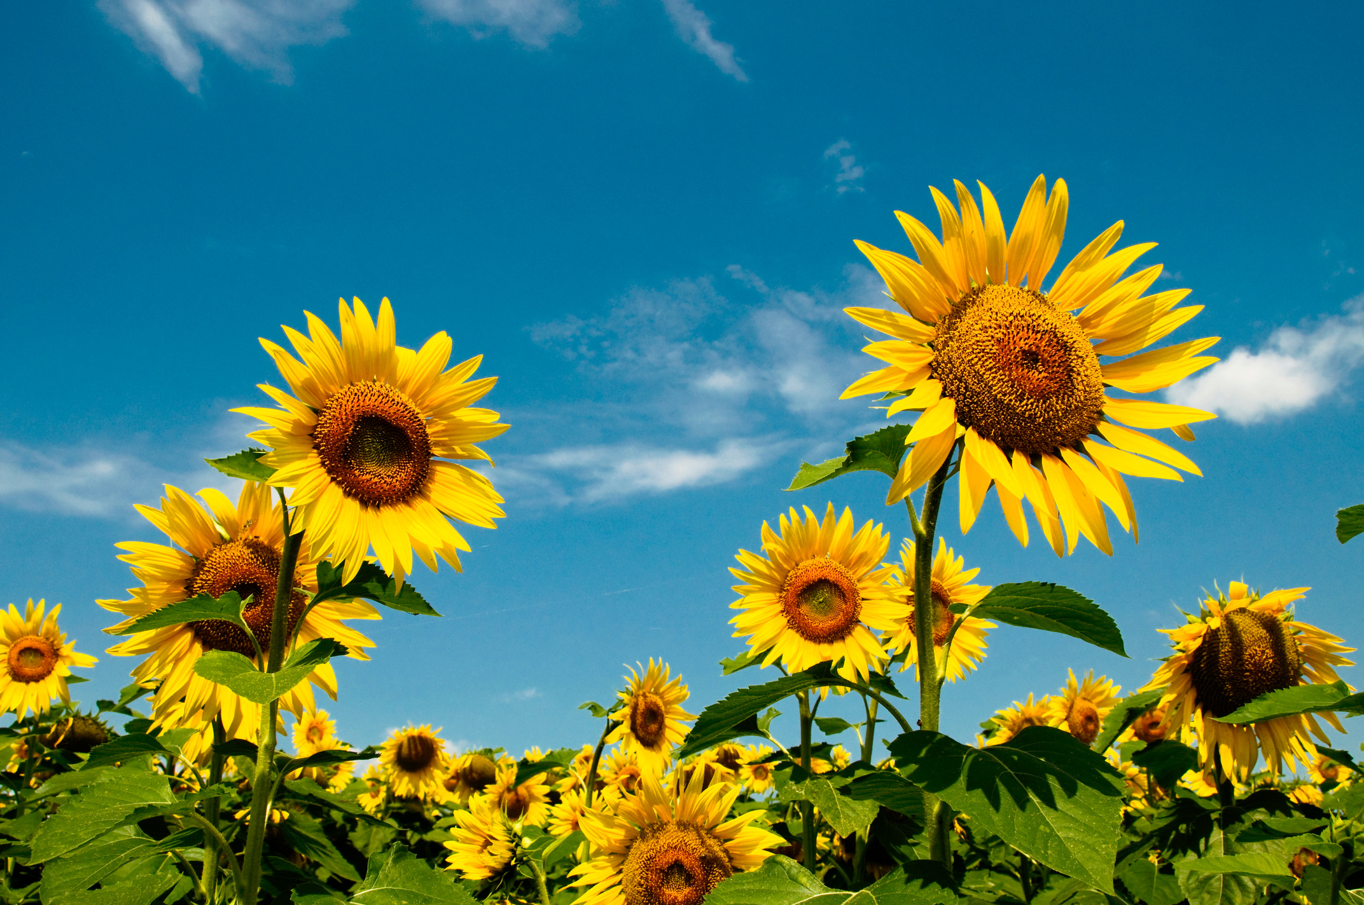

Year 7 Summer Term

Slide 2
Year 7 Overview
Aspirational outcomes for year 7 based on Bloom’s Affective Taxonomy (Anderson & Krathwohl, 2009). Receiving: Has an awareness of individual emotional differences, shows a willingness to hear and learn about emotional diversity.
Progression in learning aims from self, to others, to community
Responding to one’s emotions with curiosity
Exploring our emotional self
Recognising the uniqueness of one’s emotions
Having a growth mindset about our emotional selves
Understanding emotional energy
Identifying and using stress-management strategies
Learning to express one’s emotional needs
Developing an awareness that different people express and experience emotions differently
Engaging in adult-led conflict resolution
Demonstrating curiosity and open-mindedness

Slide 3
Summer Term | Aims | Objective | Activity * Requires photocopying
Week 1 | Revisiting prior learning | Reconnecting through colour | Inside Out
Week 2 | Learning to express one’s emotional needs | Exploring the link between emotions and behaviours
Week 3 |  | Connecting our emotions and behaviours
Week 4 | Developing an awareness that different people express and experience emotions differently | Reflecting on our own ways of expressing different emotions | * iii
Week 5 |  | Comparing our own and other’s ways of expressing emotions
Week 6 | Engaging in adult-led conflict resolution | Noticing emotions during conflict | For The Birds
Week 7 |  | Exploring how conflict might arise
Week 8 | Demonstrating curiosity and open-mindedness | Exploring colour association across different cultures | Cultural Colours
Week 9 |  | Exploring words from around the world | World Words
Week 10 | Reflecting on the year | Exploring growth and learning | Revisiting Year 7 Connecting Through Colour

Slide 4
Year 7 Summer Term Week 1
Learning Objective: Reconnecting through colour | Activity: Inside Out
Instructions: Invite the students to share anything they remember from last term, you can prompt e.g. linking colour and emotion, perspective taking, how activities change our emotions. Explain that they are going to watch a clip from inside out. Ask them to notice which colours Riley links to which emotions. | Questions for engagement: Before videos: What did we learn last term about how we express our emotions? After each video: What colours were Riley’s emotions and what colour would yours be?
Resources: Colour charts

Slide 5
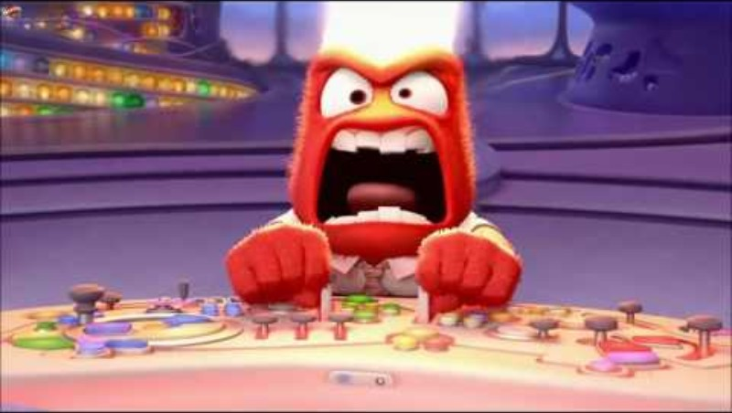

Slide 6
Year 7 Summer Term Week 2
Learning Objective: Exploring the link between emotions and behaviours | Activity: Inside Out
Instructions: Explain to the students that they are going to watch the Inside Out video again. Invite them to note down what Riley is doing that might suggest she is joyous. Play the clip for ‘joy’, pause, then discuss. Complete this for the rest of the emotions. | Questions for engagement: Does anger (or any of the emotions) always look like this? How else might joy (or any of the emotions) be expressed?
Resources:

Slide 8
Year 7 Summer Term Week 3
Learning Objective: Connecting our emotions and behaviours | Activity: Inside Out
Instructions: Ask students to think back to the video, pick one of the emotions, and discuss with a partner how they each might show that emotion. | Questions for engagement: What is the same and what is different in the way you and your partner show that emotion?
Resources:

Slide 9
Year 7 Summer Term Week 4
Learning Objective: Reflecting on our own ways of expressing different emotions | Activity: iii
Instructions: Give each student the iii activity sheet Explain that they are going to work on their own to think about what emotions connect to the three colours. Ask them to either write or draw the emotions on the faces. Ask them to think about the way they might show each of the three emotions and note or draw these on the bodies. Please collect these in and keep for the following session. | Questions for engagement: Think about a time you might have felt this colour. Think back to Inside Out if that helps.
Resources: iii activity sheets

Slide 11
Year 7 Summer Term Week 5
Learning Objective: Comparing our own and other’s ways of expressing emotions | Activity: iii
Instructions: Give each student their iii activity sheet from last time. Explain that they are going to work with a partner to discuss what they each put on their sheets. | Questions for engagement: What were the similarities and what were the differences?
Resources: Their iii activity sheets from the previous session.

Slide 12
Year 7 Summer Term Week 6
Learning Objective: Noticing emotions during conflict | Activity: For The Birds
Instructions: Explain that they are going to watch a Pixar short (it has sound). Invite the students to notice any emotions displayed by the birds and find a colour which matches it on their charts. Once the film has ended, structure a think, pair, share discussion about the different colours and emotions. | Questions for engagement: Which colours did you notice? What different emotions did you notice?
Resources: Colour charts

Slide 13
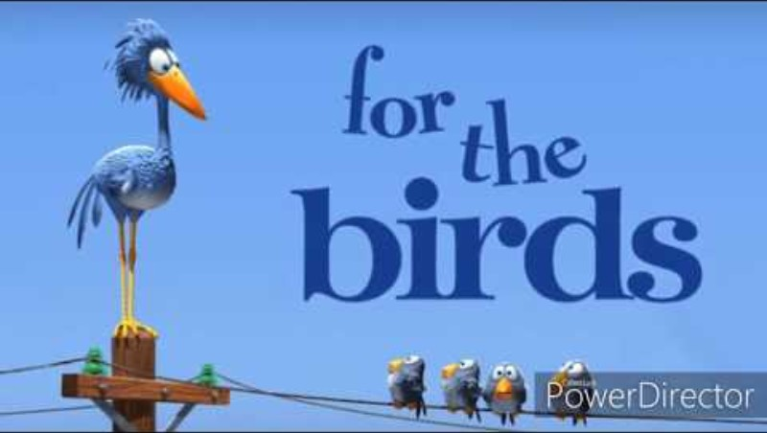

Slide 14
Year 7 Summer Term Week 7
Learning Objective: Exploring how conflict might arise | Activity: For The Birds
Instructions: Explain to the class that they’re going to watch For The Birds again. This time invite them to explain what they notice happening in the video. | Questions for engagement: Did all the birds get on? If not, why not?
Resources:

Slide 16
Year 7 Summer Term Week 8
Learning Objective: Exploring colour association across different cultures | Activity: Cultural Colours
Instructions: Explain that they will see 4 slides featuring different uses of colour from around the world. Show the slide and ask the class what they think the images are. Show them the next slide with the explanations and invite any thoughts. | Questions for engagement: Are any of these familiar to you? Do any of these surprise you?
Resources:

Slide 17
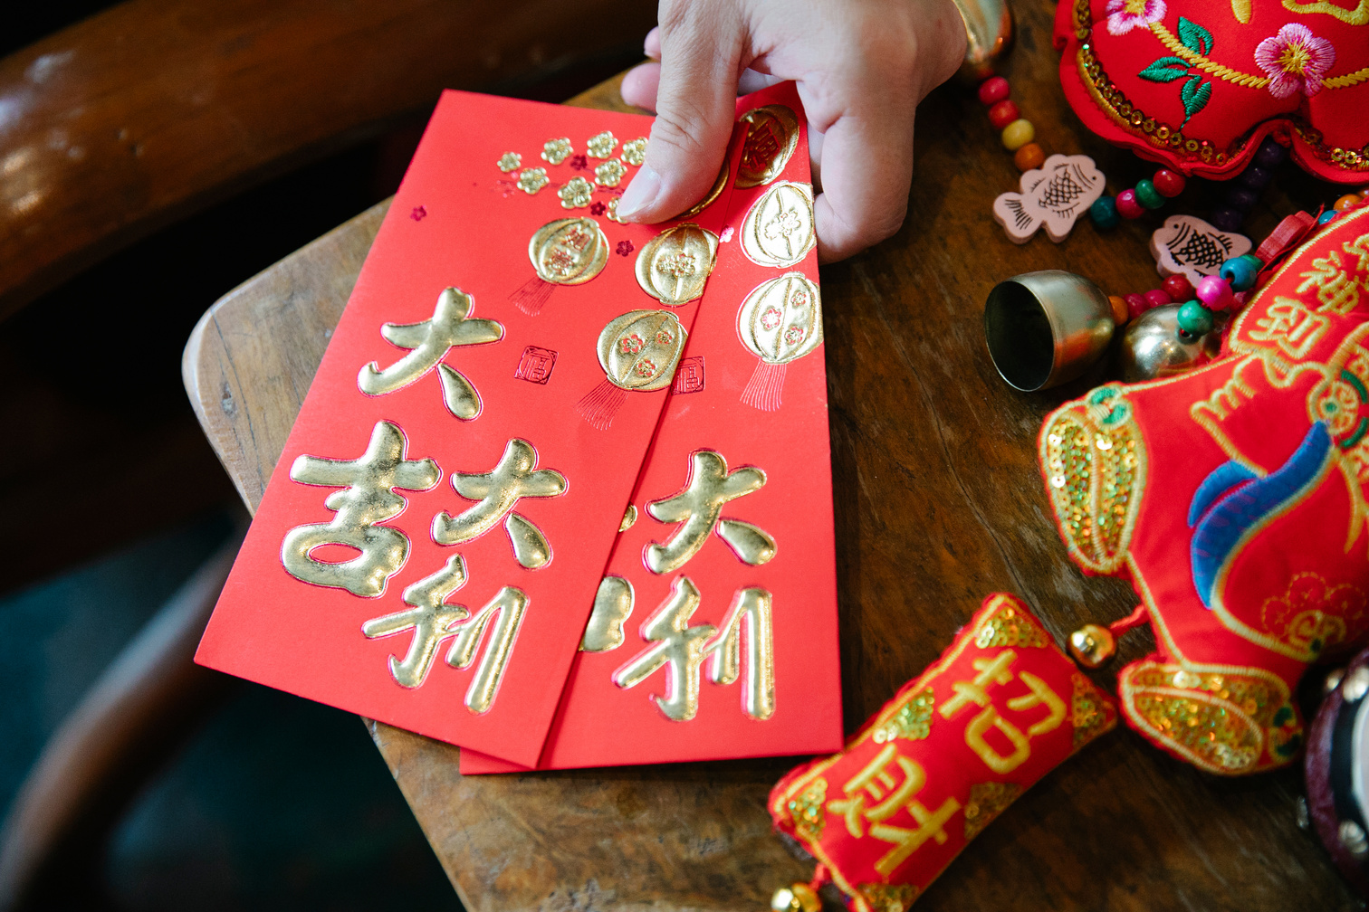
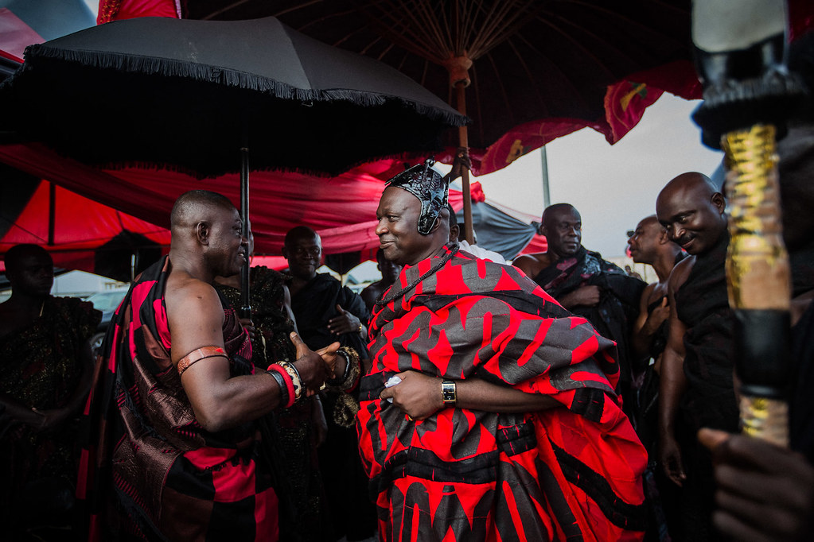
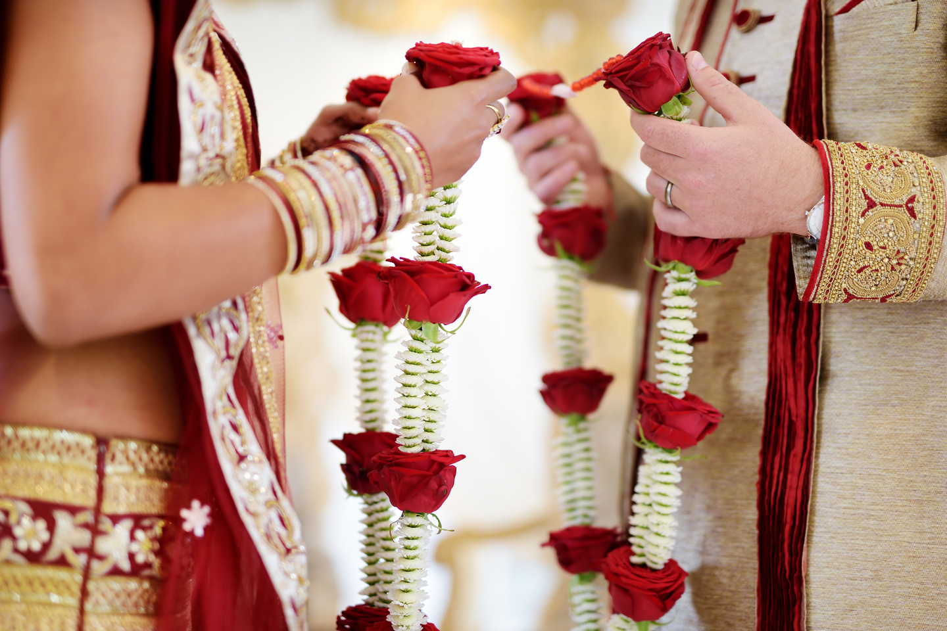

Slide 18
Chinese red envelopes used for gifting someone money
A Ghanaian Funeral
A Hindu Wedding

Slide 19
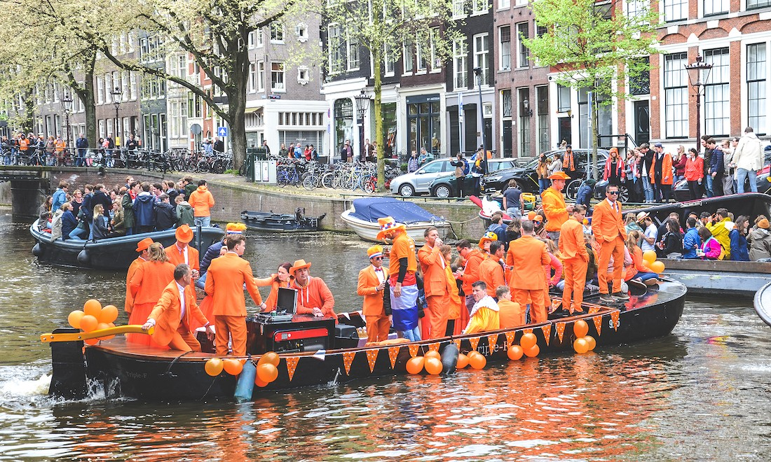
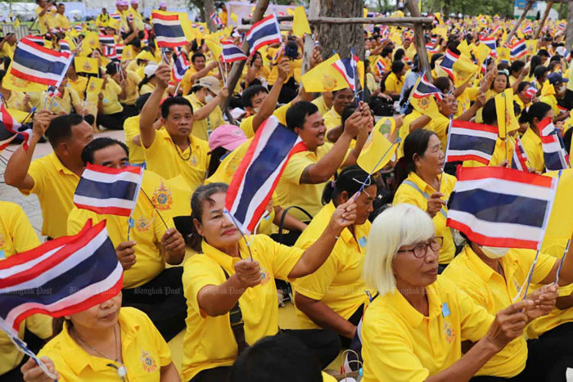
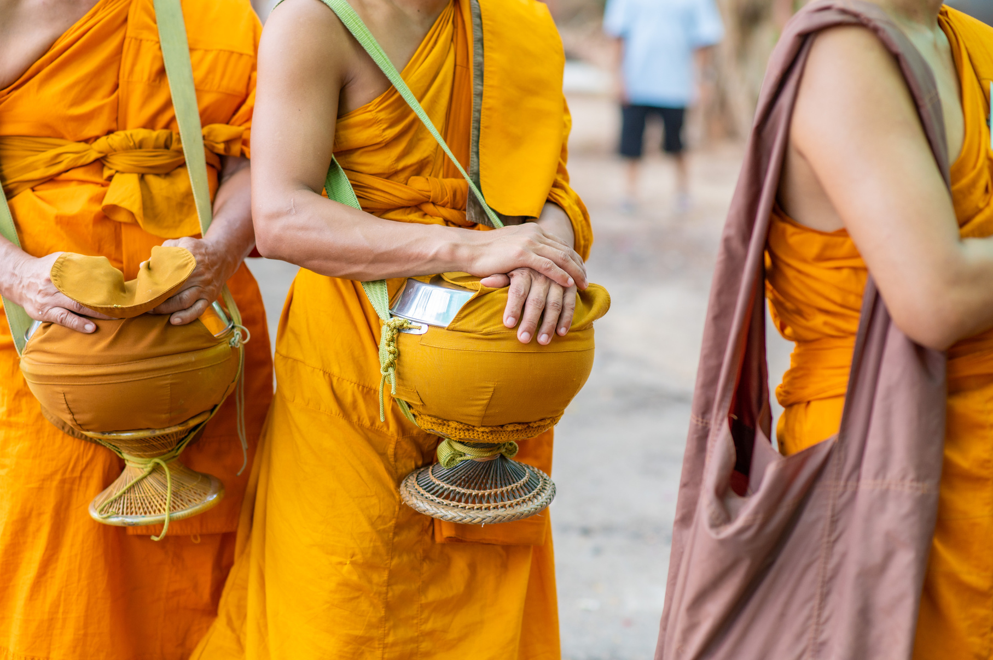

Slide 20
Many Thai people wear yellow on Mondays as a sign of respect and loyalty to the king.
Orange is the Dutch national colour of celebration.
Buddhist monks wear yellow, as well as orange or red, depending on the occasion.

Slide 21
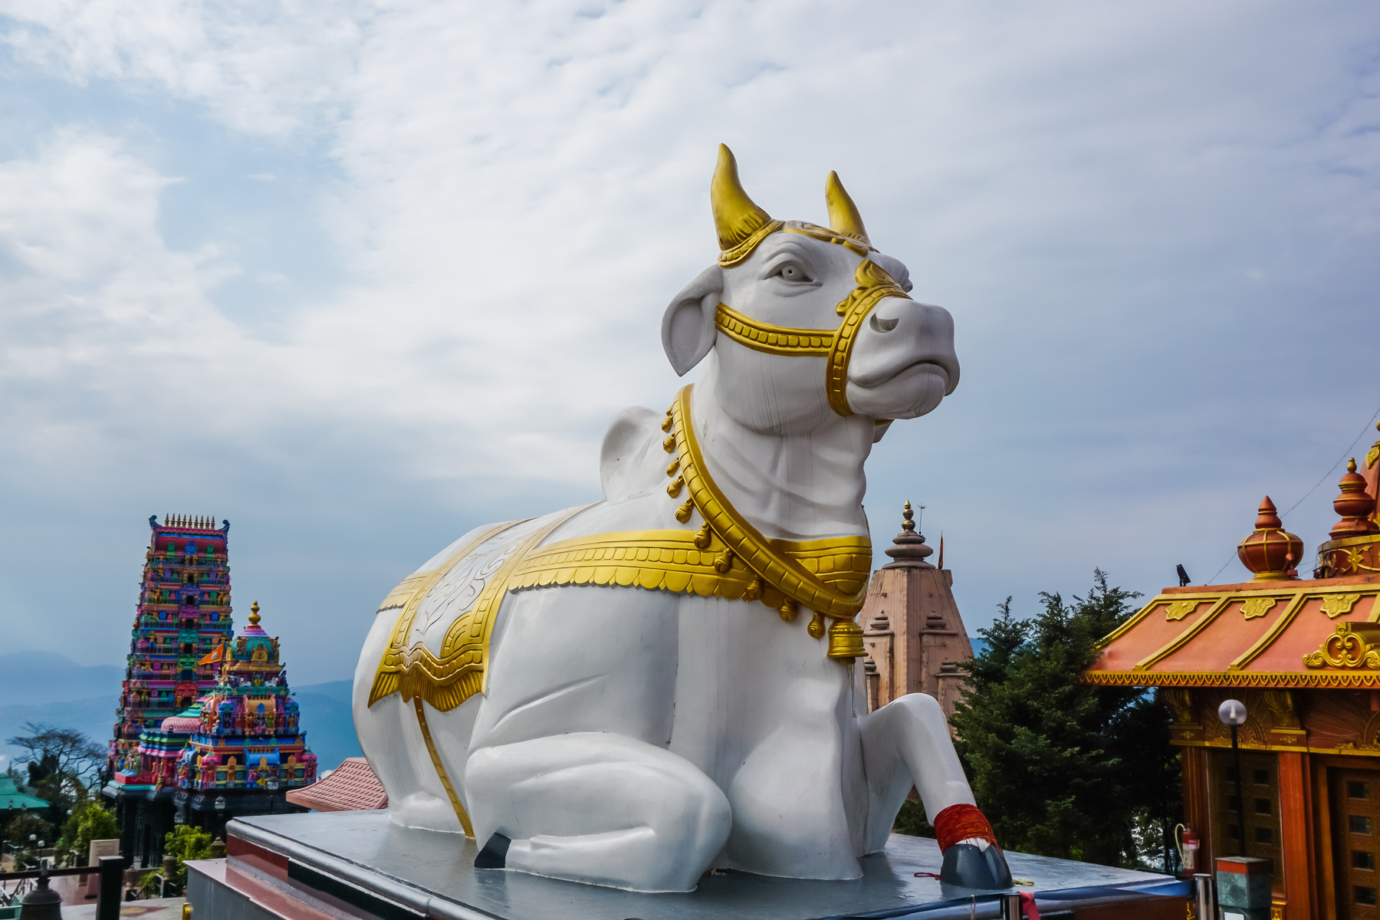

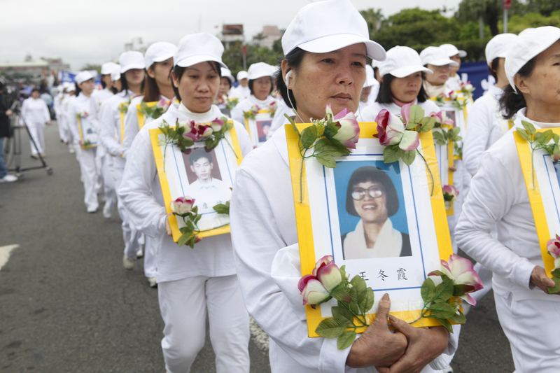

Slide 22
Sacred cows in India, and Sacred Buffalo in Native American cultures, are white.
In the West brides often wear white to get married.
In China white is often worn when someone dies.

Slide 23
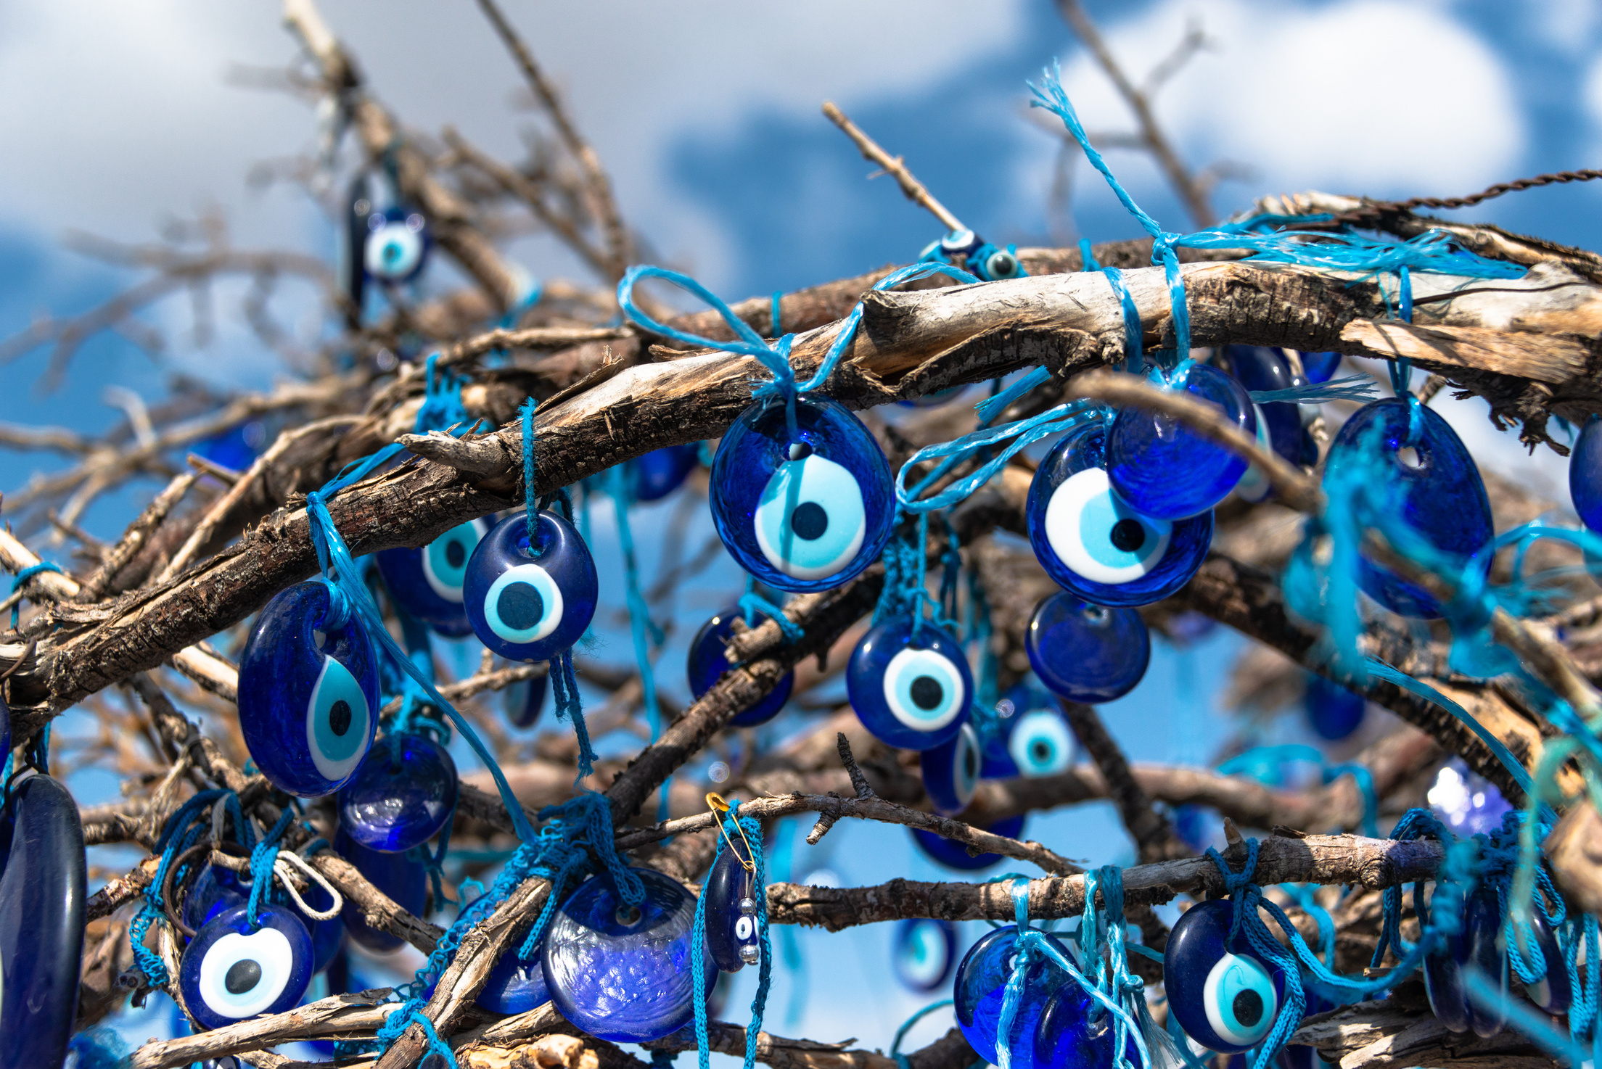
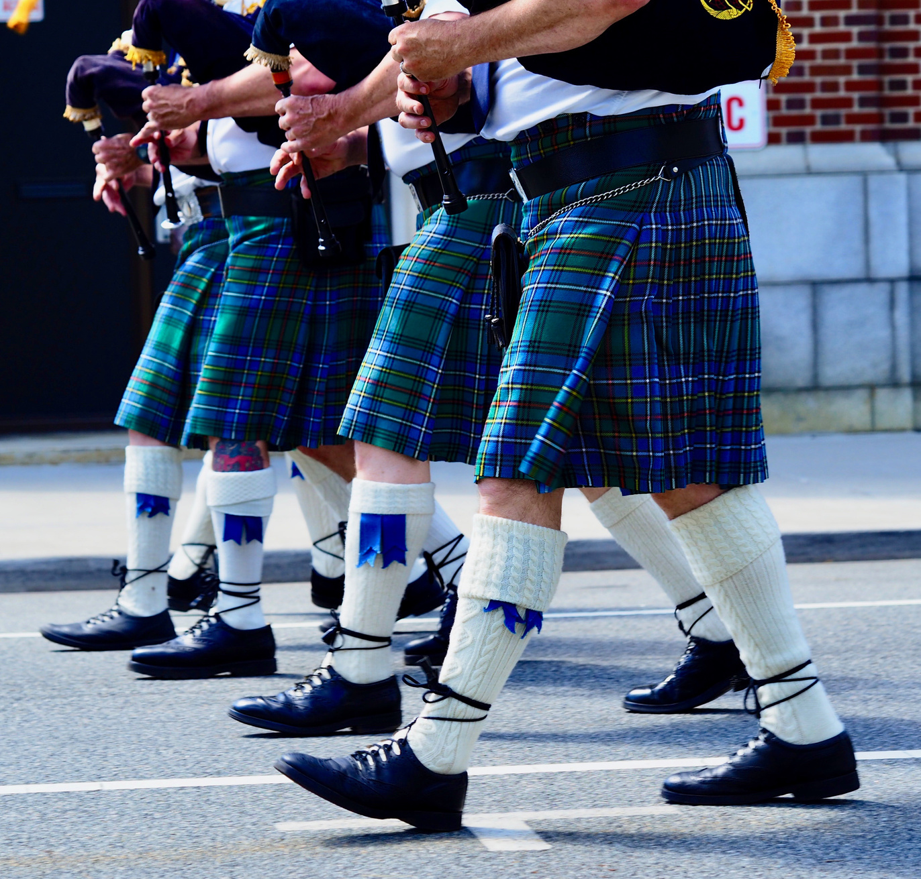
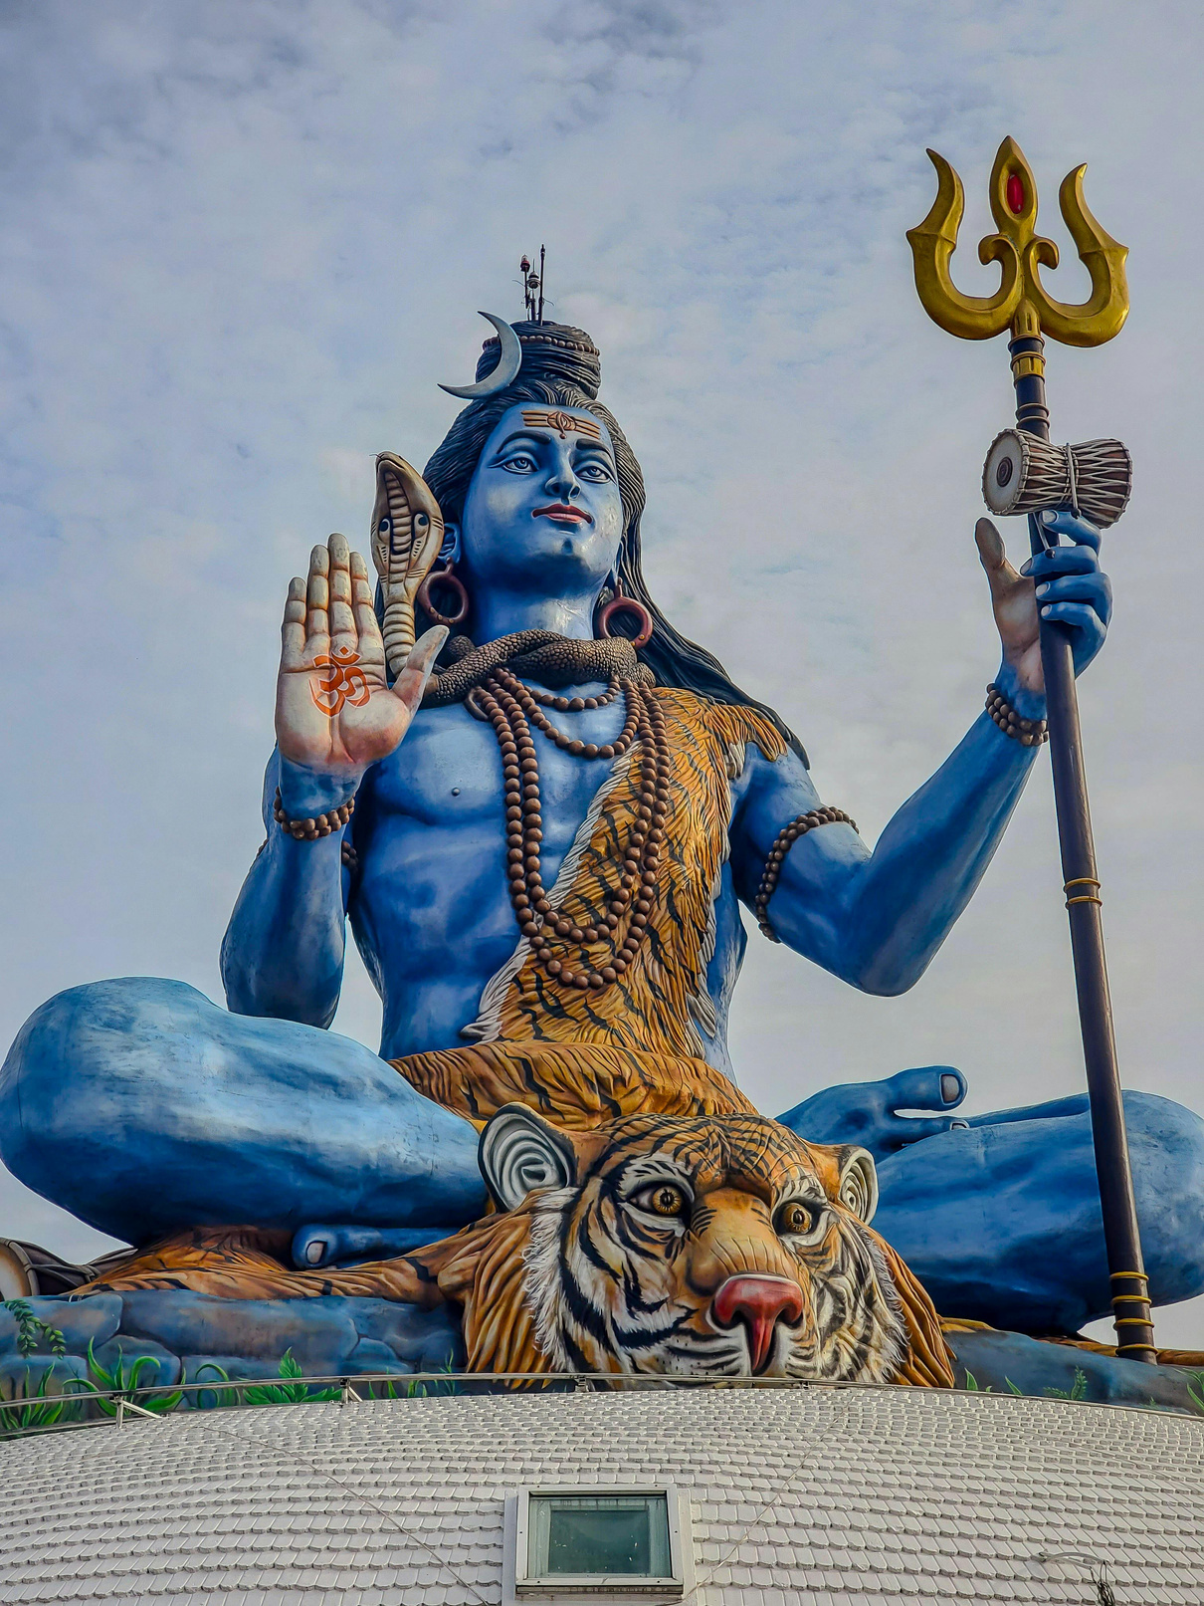

Slide 24
In Greece Evil Eyes ward off bad luck.
Blue is a very common colour in tartan which is used to represent a clan or family.
Shiva is a Hindu god who is blue because he drank poison to save the world.

Slide 25
Year 7 Summer Term Week 9
Learning Objective: Exploring words from around the world | Activity: World Words
Instructions: Explain that they will see 4 different words which express emotion from around the world. Each slide has the word, the country of origin and a clue. Show the slide and invite the students to point to a colour on their chart which they think might reflect the word. Show them the definition on the following slide and invite any thoughts. Repeat for all 4 words. | Questions for engagement: Are any of these words familiar to you? Are there any of these words that you like?
Resources: Colour charts

Slide 26

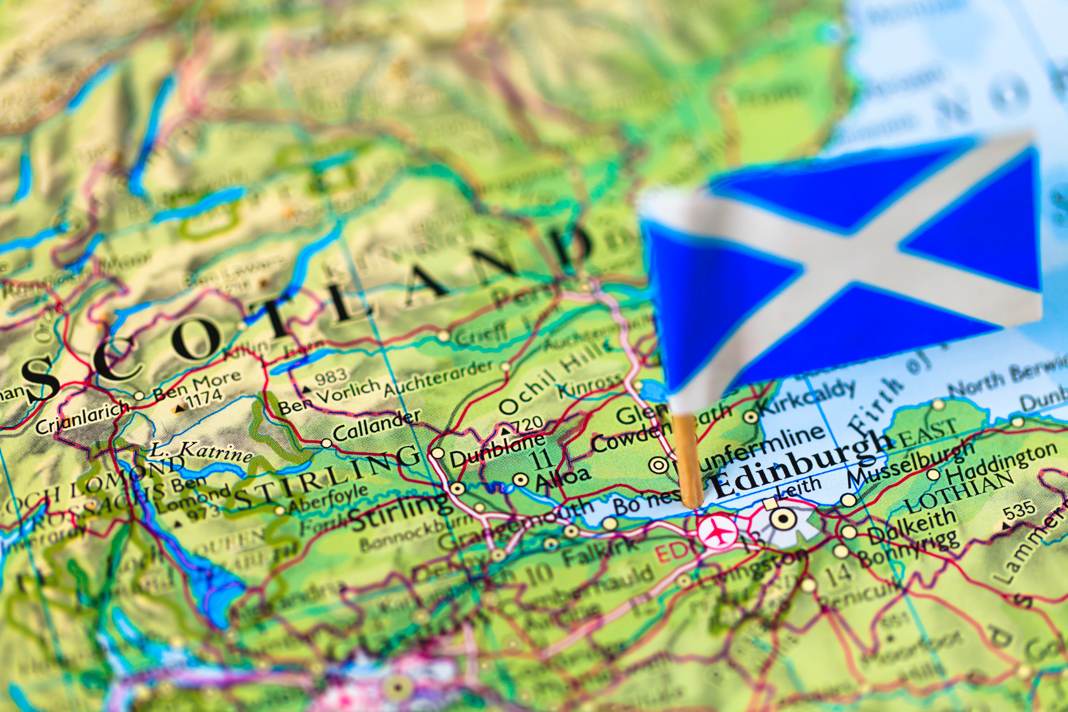
Tartle

Slide 27
Tartle: A sudden rush of embarrassment, panic, and self-consciousness when you realise you’ve forgotten someone’s name just as you’re about to introduce them.

Slide 28


Amae

Slide 29
Amae: It’s the feeling of being able to let your guard down, be vulnerable, and trust that the other person will look after you.

Slide 30

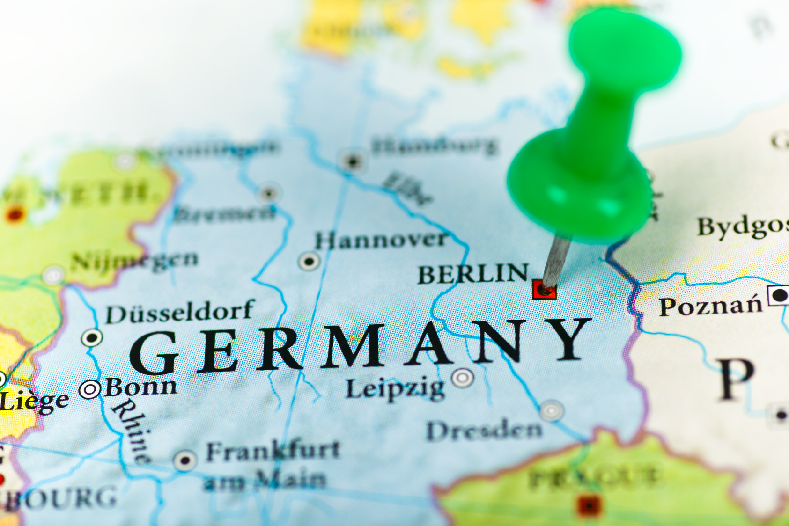
Schadenfreude

Slide 31
Schadenfreude: The pleasure or satisfaction you feel when you see someone else experience misfortune, failure, or embarrassment.

Slide 32
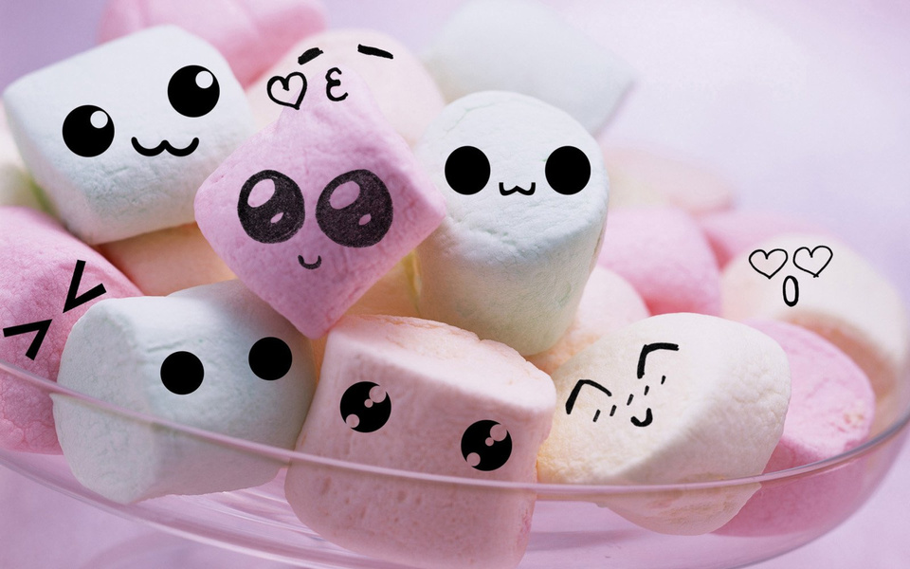
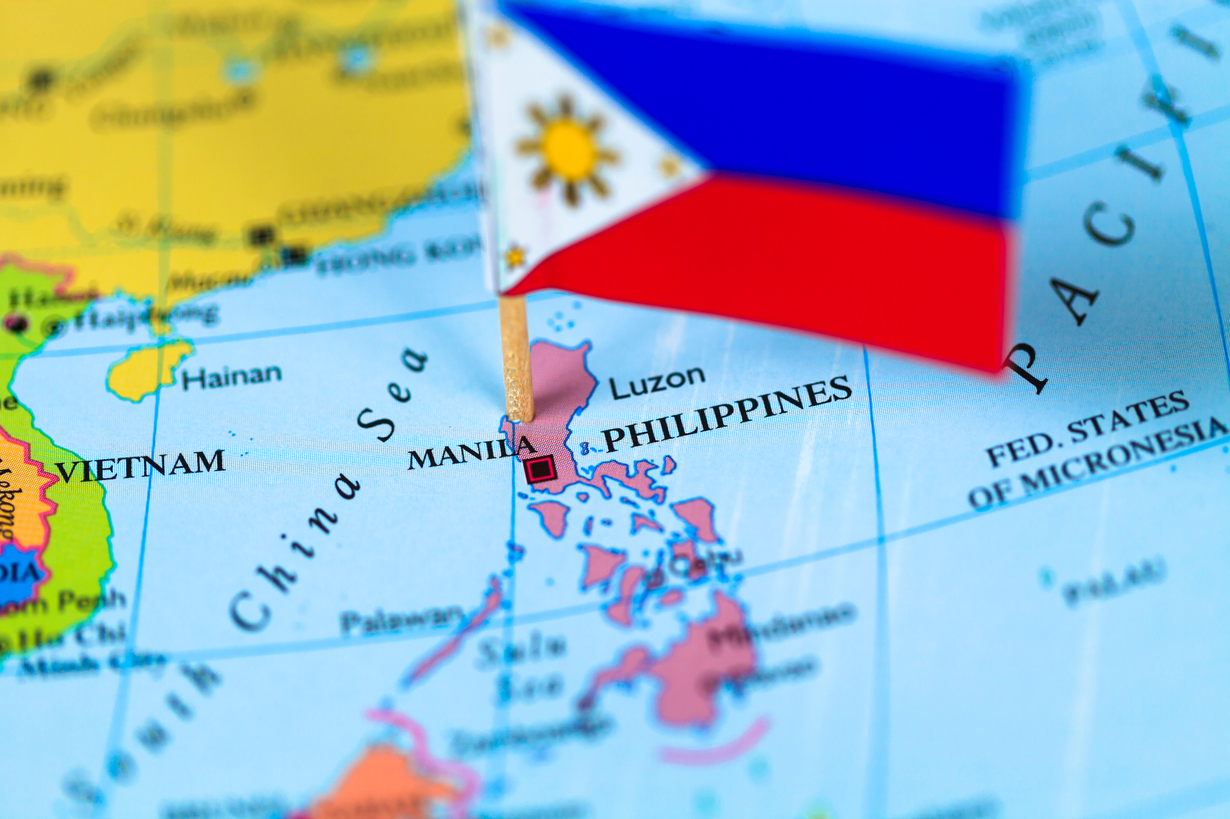
Gigil

Slide 33
Gigil: Is the overwhelming, almost uncontrollable urge to squeeze, pinch, or cuddle something (or someone) you find incredibly cute.

Slide 34
Year 7 Summer Term Week 10
Learning Objective: Exploring growth and learning | Activity: Revisiting Year 7 Connecting Through Colour
Instructions: Invite the students to reflect on their Connecting Through Colour sessions for the year. Ask them which of the activities they would like to revisit today and then redo that session with them. | Questions for engagement: How have you found Connecting Through Colour? What have you gained from the sessions? What did you find easy or difficult?
Resources: Dependent on the session chosen.

